Slide 1
PIXENTURE LABS📸
NAME:SANDESH SURESH PATE
ROLL NO : 14408
NAME: SHIV SANTOSH SARODE
ROLL NO: 14489

Slide 2
SYNOPSIS
Topic / Project Title | Pixenture Labs
Name Of Group Members | Shiv Sarwade (14489) Sandesh Pate (14408)
Technology | • Html5 • CSS3 • JavaScript (ES6)
Objective / Aim | • Increasing Reach of Studio • Providing information to customer of studio services • Providing potential customers one stop option for all type of services like photography , cinematography, B-rolls , A-rolls , Animation and many more services

Slide 3
Index
1. Introduction
2. Objectives
3. Scope
4. Hardware and Software requirements
5. System Design
6. Layout of the Website
7. Conclusion
8. Bibliography

Slide 4
Introduction
Pixenture Labs is an online one-stop solution for exceptional photography and videography services. Their commitment to excellence is reflected in every aspect of their platform. With a team of certified photographers boasting a minimum of 3 years of experience in their respective fields, Pixenture Labs guarantees professionalism and expertise in every shot. The dedication to customer satisfaction is evident through their 200+ satisfied clients, who trust them to capture their most cherished moments.
Understanding the challenges of scheduling shoots, Pixenture Labs has streamlined the process with their user-friendly platform, making it easy and convenient for clients to book their sessions. They prioritize providing the highest quality services at the most affordable prices, ensuring that exceptional visual storytelling is accessible to all.
Additionally, Pixenture Labs goes above and beyond by offering zero traveling fees within Maharashtra, making their services even more accessible to local clientele. As a token of appreciation for choosing Pixenture Labs, they delight their clients with gifts and hampers upon completion of their projects, adding a personal touch to their professional relationship.
Furthermore, Pixenture Labs prides itself on utilizing high-end, top-notch photography tools and technologies to ensure the best possible outcome for every project. When clients choose Pixenture Labs, they can rest assured that they're receiving nothing less than premium quality in every aspect of the service delivery. Joining Pixenture Labs means entrusting your moments to a team dedicated to transforming them into timeless treasures.

Slide 5
Objectives
> To create a user friendly platform where they can book there services conveniently
> To enhance user experience through easy and attractive UI process than offline tedious process
> To provide high quality services with less prices
> To provide one stop solution for all kind of services
> Foster Easy communication between client and photographers and videographers
> Attracting customers from not only local area but as well from world wide
> To decrease the cost of offline marketing by doing it online in more cheaper ways which are having exponentially more impact
> Making the whole process transparent by showcasing website online and assuring quality by posting project photos which can be seen whenever and from wherever customer wants
> To make booking and scheduling process easy for lab as well since its difficult offline more

Slide 6
Scope
> Pixenture Labs specializes in providing a wide array of photography and videography services, covering weddings, events, portraits, and commercial projects.
> The platform boasts a team of certified photographers and videographers, guaranteeing professionalism and expertise in every project.
> Clients enjoy a seamless booking process and effective communication through a user-friendly interface.
> Transparent pricing and package options cater to diverse budgets and preferences, ensuring affordability and flexibility.
> With zero traveling fees within Maharashtra, Pixenture Labs extends its accessibility to local clientele, offering convenience and value for money.
> Based on the needs of clients we can decide best price and plan for their events or work
> Even client can customize his project and can mix two or more types so he can get more desired results and save cost as well
> Saves lot of time and money than showcasing projects and marketing services by offline ways.
> Attracts more customers from worldwide since anyone can see website with any available tool whether its mobile tablet or laptop or pc as well

Slide 7
Hardware and Software requirements
> Hardware
1. Laptop or PC Requirement:-
1.1 Processor of i3 5th gen / Ryzen3 3rd gen / Intel Pentium
1.2 RAM of at least 500mb
2. Mobile or Tablet Requirement:-
2.1 Snapdragon 150 or Unisoc 3100
2.2 RAM of at 500mb
> Software
1. Windows 7 or Android 4.1
2. Chrome or Safari or brave or edge any browser available

Slide 8
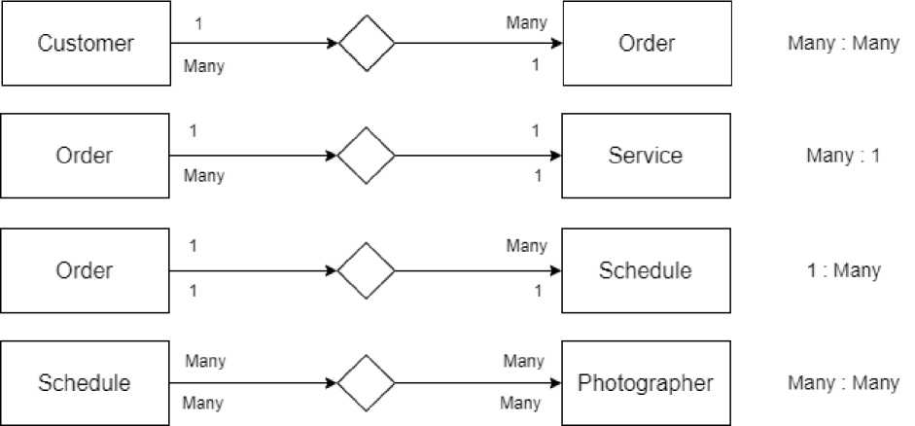
System Design
ERD

Slide 9
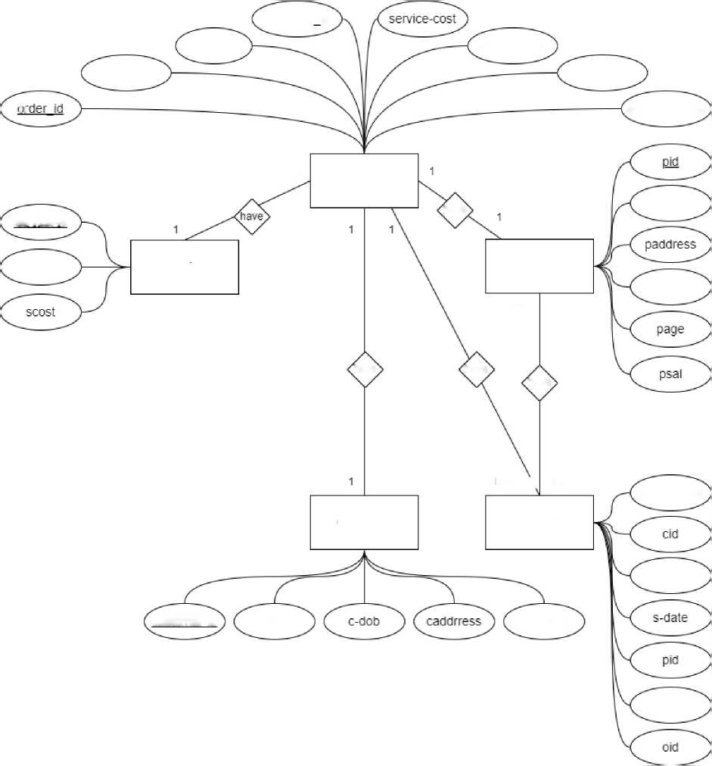
schedule id
customerjd
cname
serive-name
date-time
: i
order-address
Many
Order
pname
service-id
have
sname
Service
Photographer
pcontact
Many
have
have
have
Many \ Many
schedule-id
Customer
Schedule
cname
customer-id
cname
ccontact
pname

Slide 10
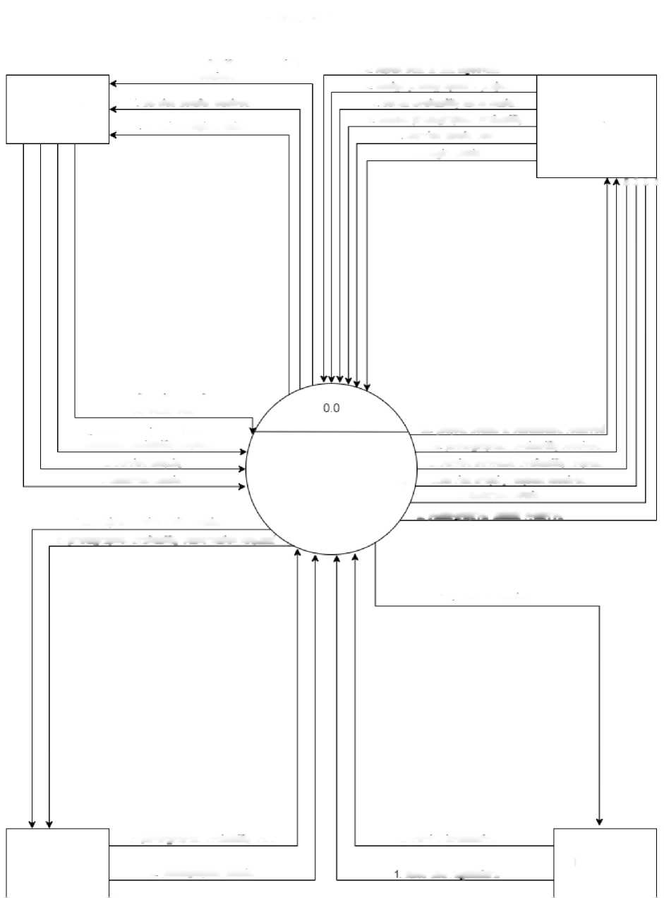
- DFD
Context level DFD
11. Schedule availability confirmation
14 report sent to management
received
13 assign photographer a project
Customer
7 service details received
11 sends availability confirmation
5 Receives login details
9 checks photographer availability
Admin
7 Service details sent
5. login details
A A A A
12. submit project details and
schedule date
12 project details & submission received
8 selects service and sends
schedule availability request
10 photographer availability received
6. service enquiry
8. service schedule availability request
4. customer datails
Photographer studio website
6.service enquiry request received
4. customer details
13. Project received with details
3. photographer details received
9. photographer availability confirmation request
14 Reports received
Photographer
10. photographer availability sent
2. service information
Management
3 photographer details
rules and regulations

Slide 11
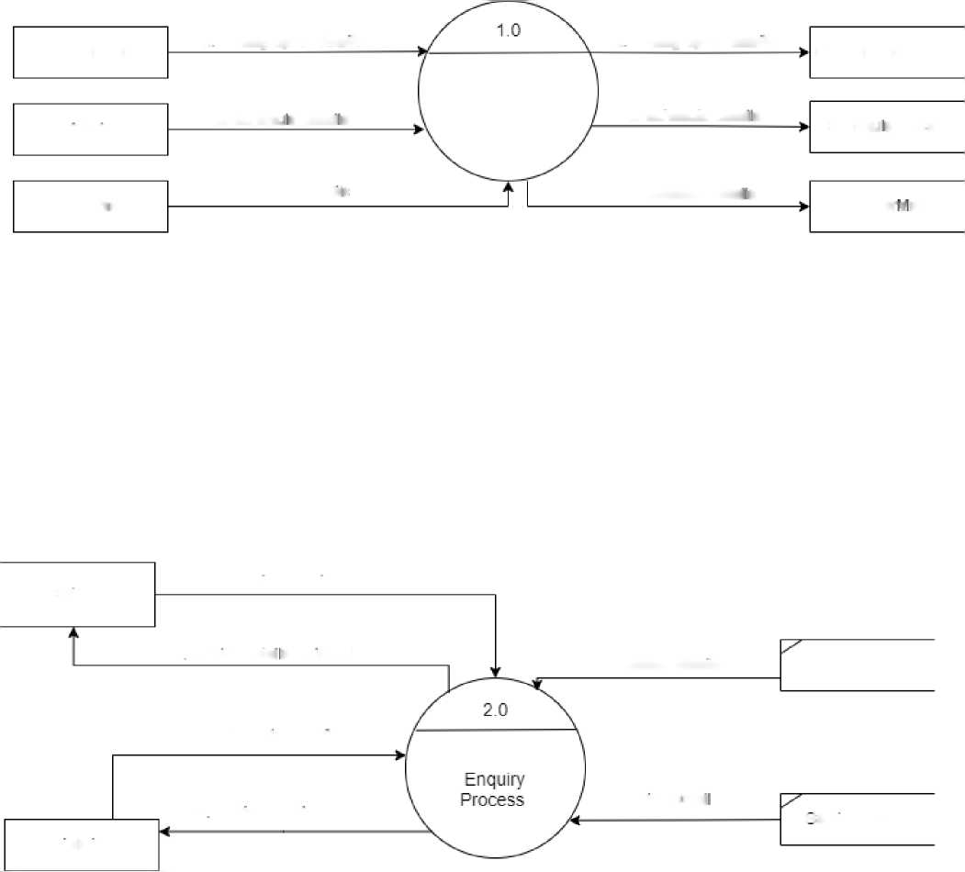
1st Level DFD
Photographer
2 Photographer details
2 Photographer details
Photographer Master
Master
Mainteance
admin
3. Schedu e Detai s
3. Scried me Detai s
Schedu e Master
Customer
4. Customer Details
4. Customer Detai s
Customer; aster
Customer
1. service enquiry
2 service detai s recieved
Customer details
Customer Master
2. service details
1 service enquiry
service Detai
service Master
rtdmin

Slide 12
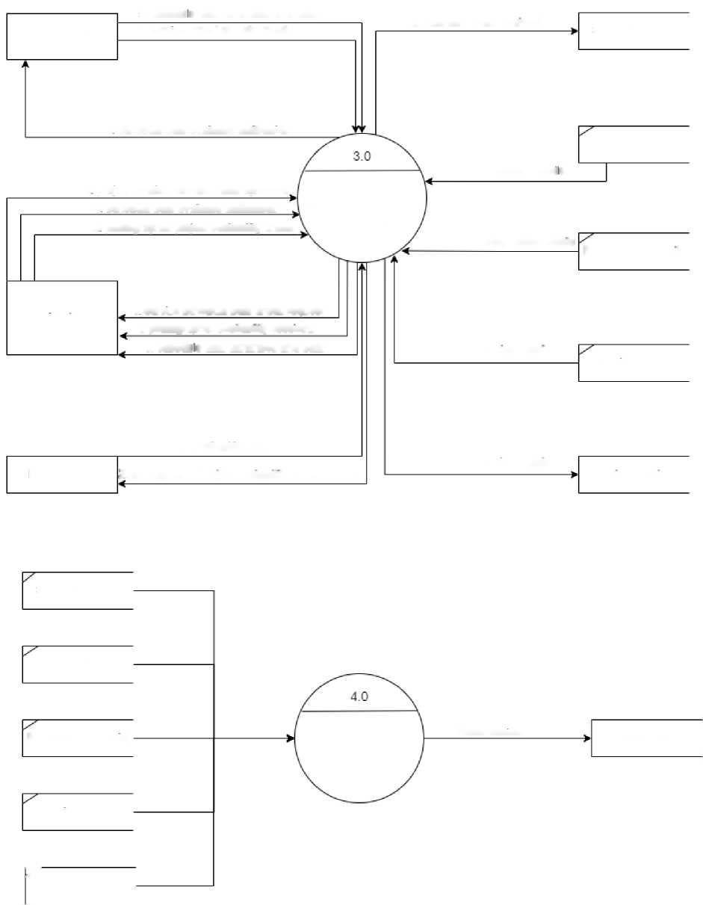
5. schedu e date confirmed and sent
6. schedule date received
Customer
1. service schedule date check
Schedule Master
4 schedule date available notification
Customer Master
6 project details schedule date uploaded
Customer detai s
4 schedule date available notification
Scheduling Project Process
2 photographer project availability check
Photographer details
Photographer details
Hdmin
1 service schedule date check request
3 photographer availability received
5. schedu e date confirmed and sent
service Detail
Service Master
3. availability sent
6. project details
Photographer
2..photographer project availability check request
project datails
schedule Master
Customer Master
Photographer details
Reports
Report received
Management
Service Master
7"
project datails

Slide 13
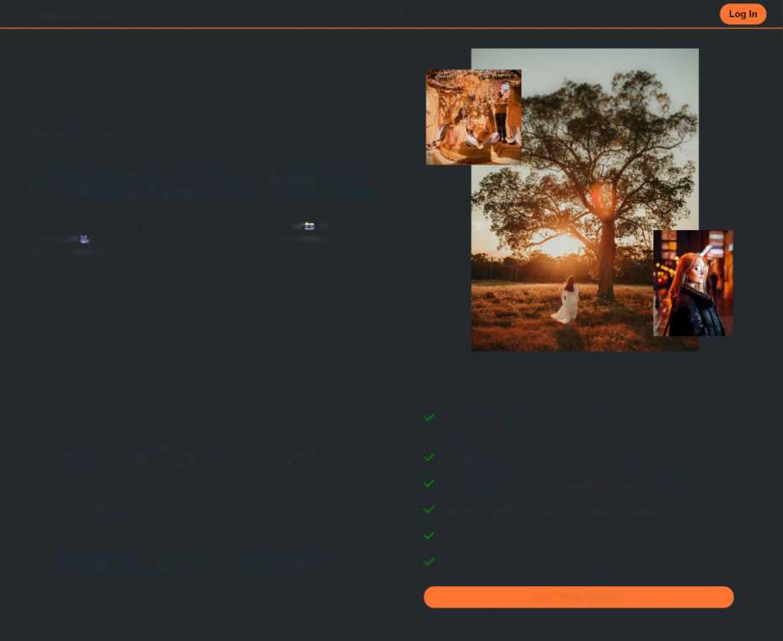
Layout of the Website
Home Page:-
Pixenture Labs
Home About Us Services Contact Us
Welcome to,
Pixenture Labs
Pixenture lab is one stop solution for all kind of Photography as well as videogrphy . You can recruit Photographers and videographers based on your requirement
Why should you choose
Pixenture Labs?
Pixenture Labs provides Specialised Photographer and Videographer
Pixenture Labs specialist are Experienced of 3+ years Pixenture Labs have 200+ Satisfied Customers® ® Easy and convinient online scheduling Process Provides services with most afffordable price in market 0 travelling charges in Maharashtra
Learn More About Us

Slide 14
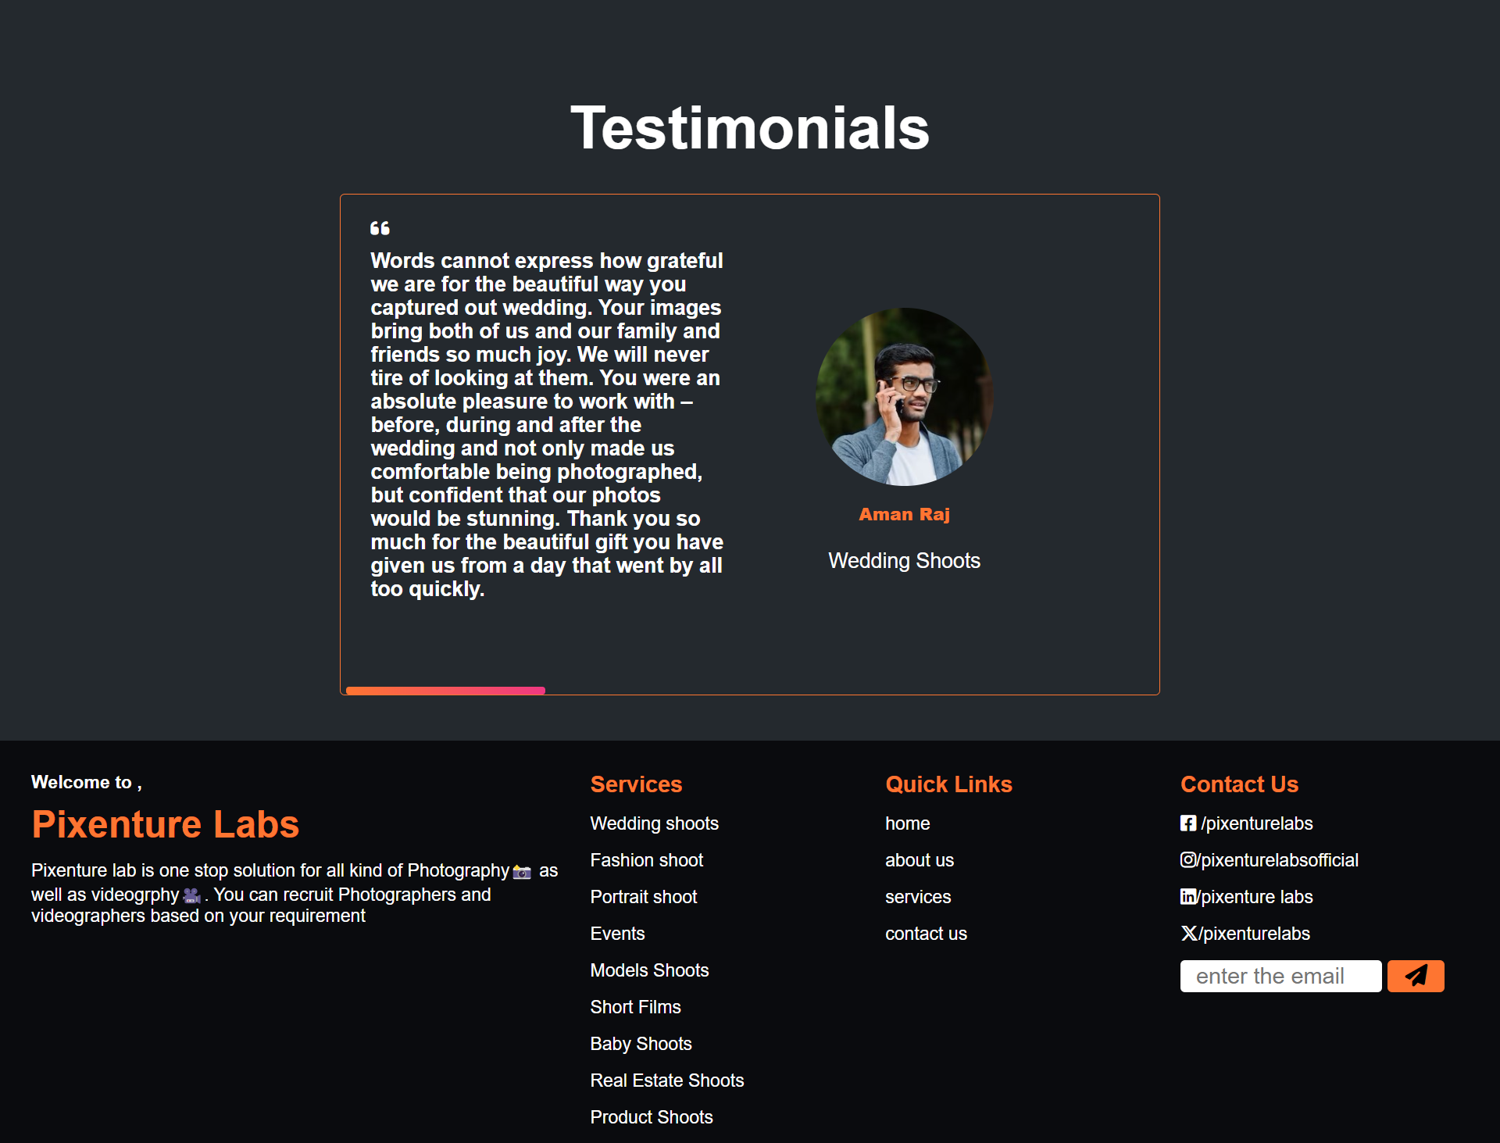

Slide 15
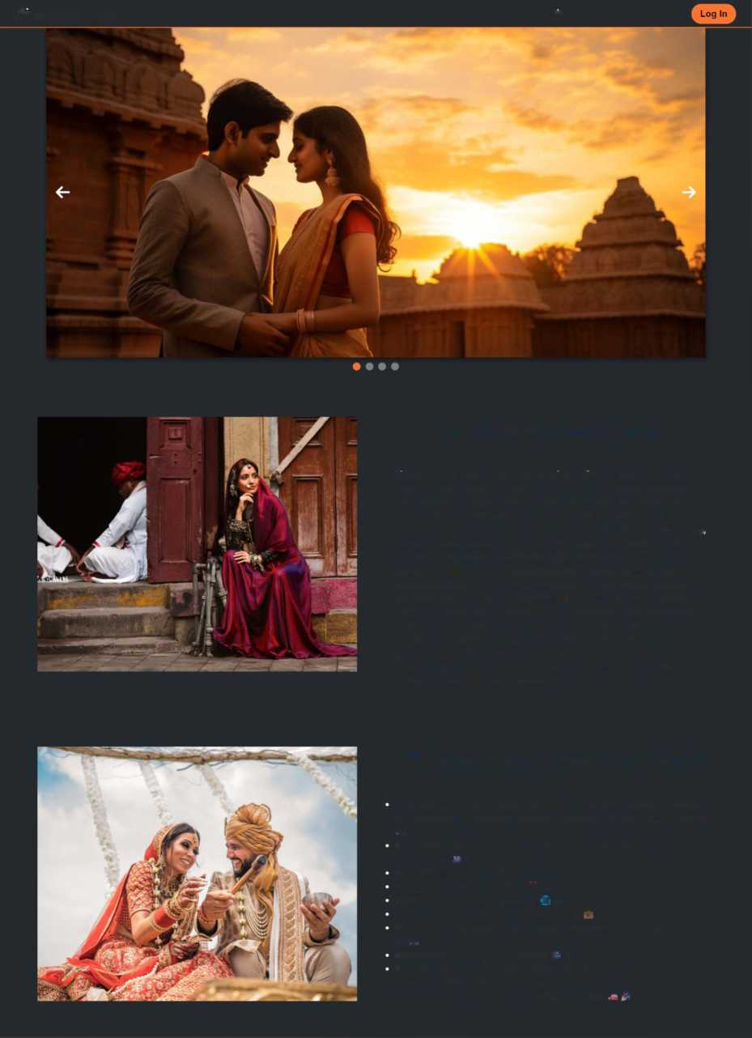
About Us Page:-
Pixenture Labs
Home About Us Services Contact Us
What is Pixenture lab?
Pixenture Lab offers a comprehensive online photography and videography solution, boasting a team of passionate, innovative, and experienced professionals. With extensive nationwide travel experience, they specialize in a wide array of projects, including baby shoots, weddings, fashion, fitness, and product photography among others. Employing artistic techniques to create unique artworks, they deliver numerous high-resolution, natural photos stored on a USB drive. Their professional photographers use a photojournalistic style, capturing emotions seamlessly. Pixenture Lab distinguishes itself by providing high-quality services, utilizing high-end equipment, offering various packages, and delivering additional complimentary products and services. With a team comprising fashion photographers, cinematographers, and professional photographers and videographers, they ensure top-notch projects at a competitive cost due to their online studio setup, eliminating rental expenses associated with offline studios.
Why to choose Pixenture Labs?
Pixenture Lab offers homely and cute online photography services for portfolios in modeling, product fashion, weddings, and more. 4ft is
Specialized photographers and videographers with over 3 years of experience. _«□
Over 200 happy customers. ® 4
Free goodies worth Rs. 1000. || 6
Convenient and easy process. ■ 9
Most affordable prices in the market $ *a
Services include indoor and outdoor portrait and portfolio shoots.
# s
Customized packages available. ». 9
Services also include automobile, event, interior, couple, wedding, fashion, family, and product photography, as well as business professional headshots and Instagram reels.

Slide 16
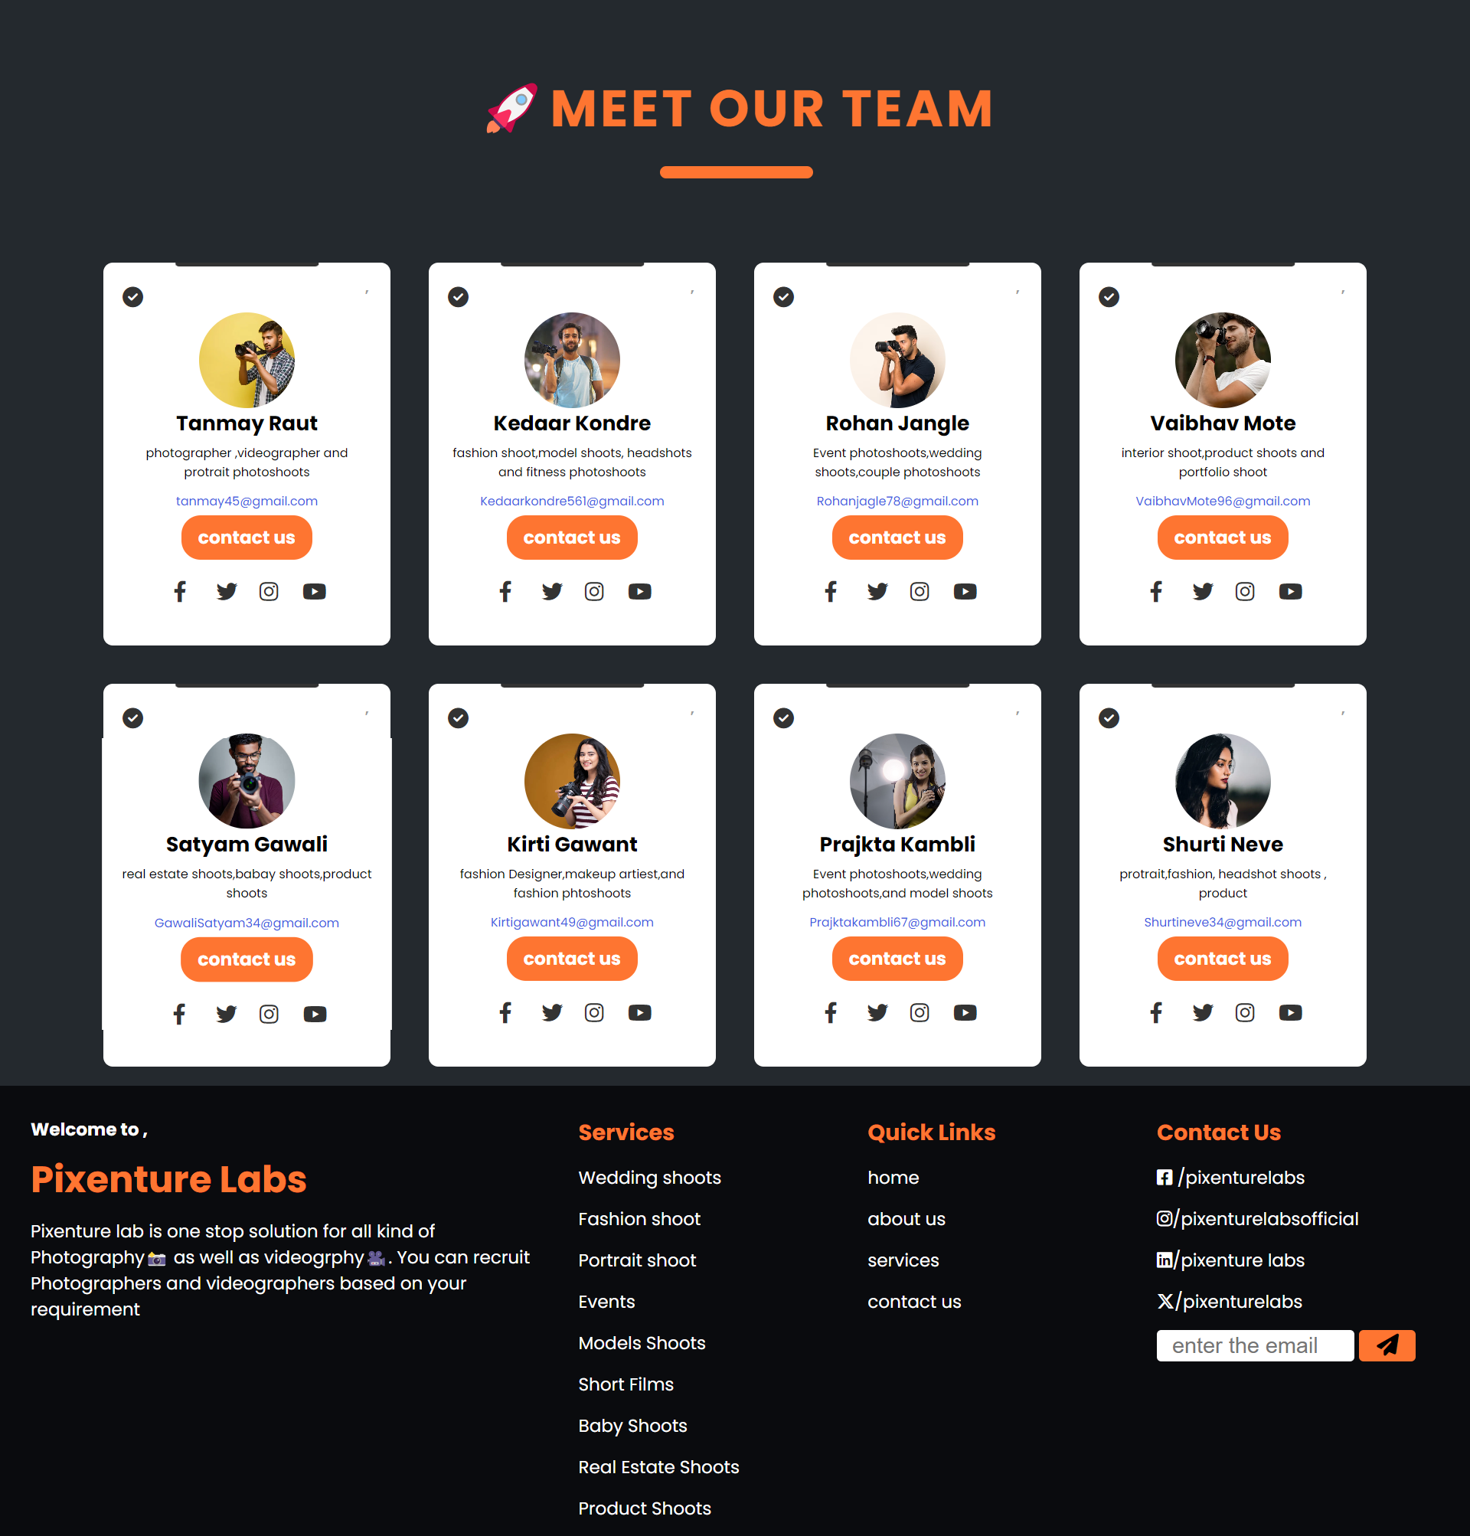

Slide 17
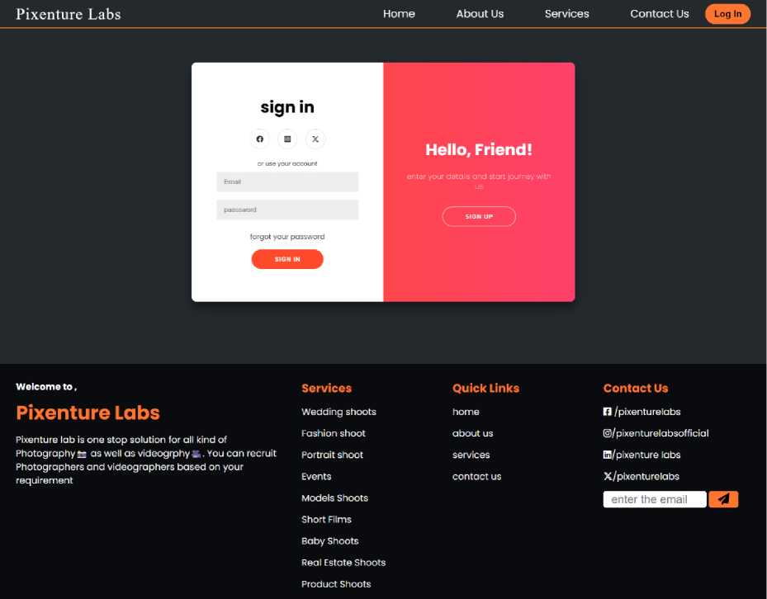
Login and Sign Up Page:-

Slide 18
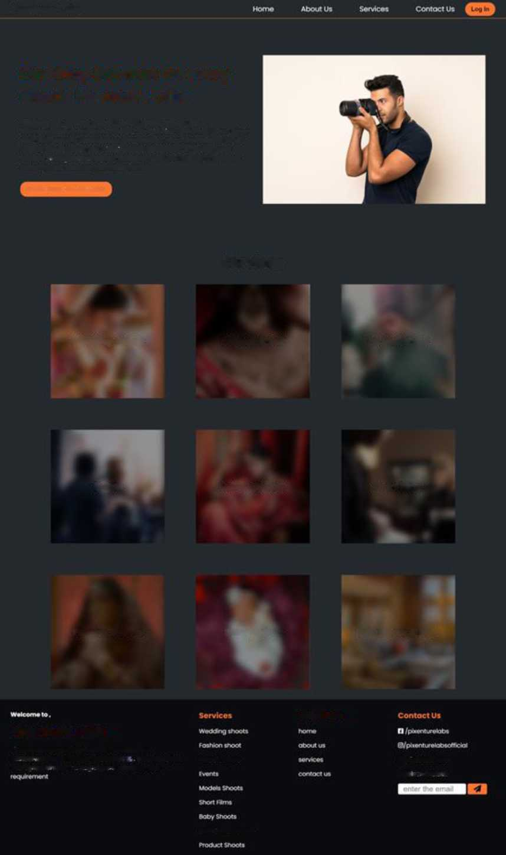

Service Page:-
Pixcnturc Labs
One Stop Solution for every shoot: Pixenture Labs
Book your moot now!
Services
Wedding shoots
Product shoot
Portrait shoot
Events
Models Shoots
Short Films
Fashion Shoots
Baby Shoots
Real Estate Shoots
Pixenture Labs
Quick Links
haenfu-eicibisonetsop solution for oft fend of
Photography tx at weft os videogrphy &. Y<M can recnit Pcrtratmoot
Photographers and videographert boeed on your
■fpaenture tabs X/pteenti#etobs
neat (state Shoots

Slide 19
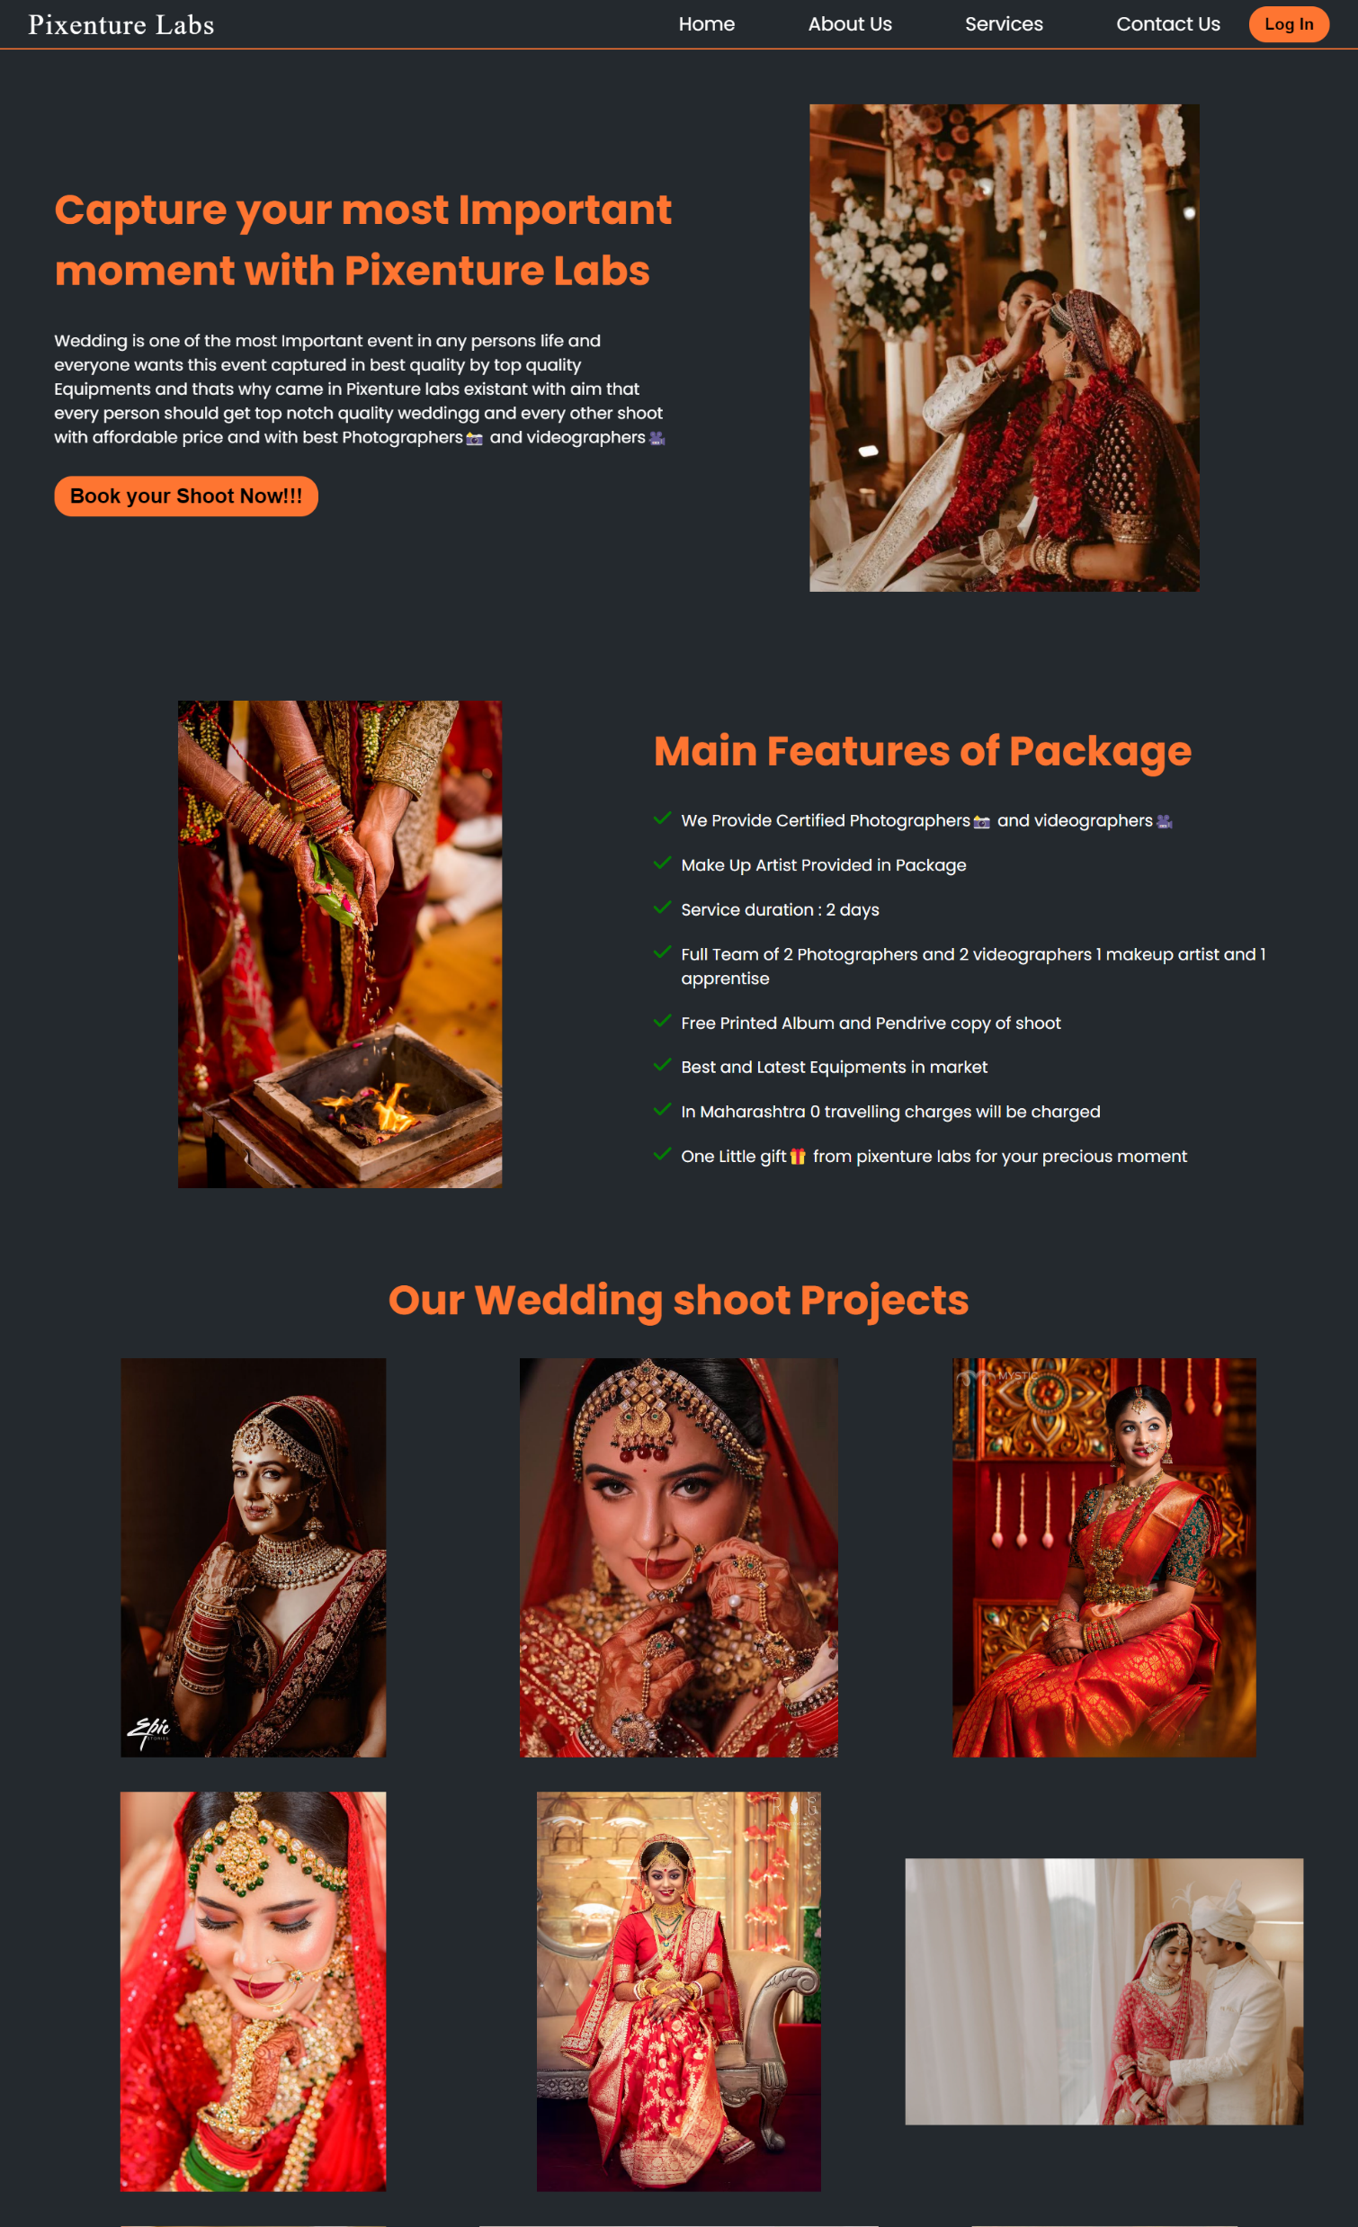
Wedding service Page:-
We Provide Certified Photographers is and videographers Make Up Artist Provided in Package Service duration: 2 days
Full Team of 2 Photographers and 2 videographers 1 makeup artist and 1 apprentise
Free Printed Album and Pendrive copy of shoot
Best and Latest Equipments in market
In Maharashtra 0 travelling charges will be charged
One Little gift If from pixenture labs for your precious moment

Slide 20
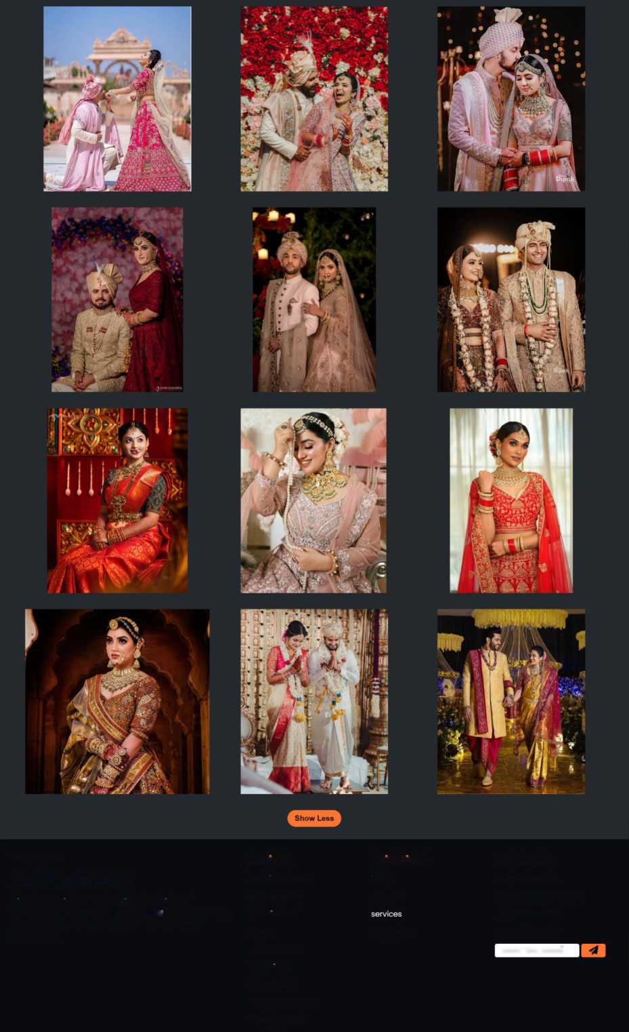
Welcome to,
Pixenture Labs
Services
Quick Links
contact Us
Wedding shoots
nome
FI /pixenturelabs 0/pixenturelabsofficial
Pixenture lab is one stop solution for all kind of Photography is as well as videogrphy i*. You can recruit Photographers and videographers based on your requirement
Fashion shoot
about us
Q3/pixenture labs X/pixenturelabs
Portrait shoot
Events
contact us
enter the email
Models Shoots
Short Films
Baby Shoots
Real Estate Shoots
Product Shoots

Slide 21
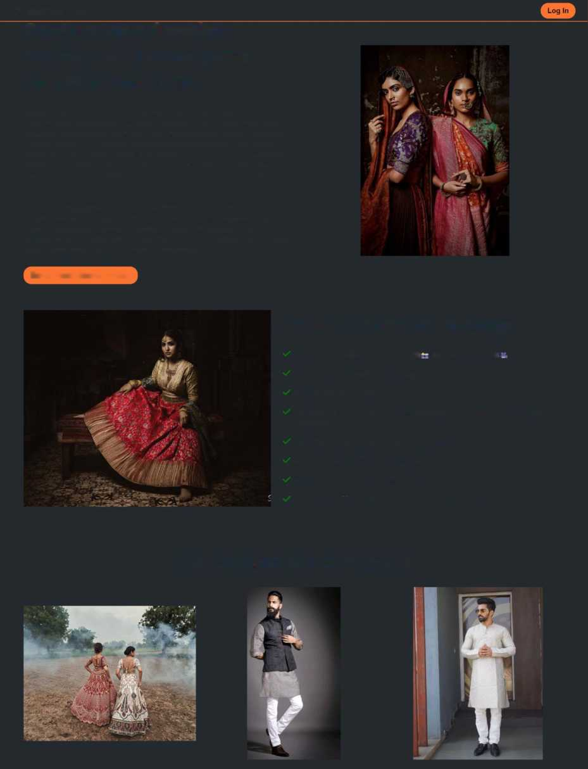
Fashion service Page:-
Pixenture Labs
Home
About Us Services Contact Us
Capture your dressing moment in fashion genre with Pixenture Labs
Fashion photography focuses on the display of fashion clothing and items.Fashion photography is a genre of photography that portrays clothing and other fashion items. This sometimes includes haute couture garments. It typically consists of a fashion photographer taking pictures of a dressed model in a photographic studio or an outside setting. It originated from the clothing and fashion industries, and while some fashion photography has been elevated as art, it is still primarily used commercially for clothing, perfumes and beauty products
Fashion photography is most often conducted for advertisements or fashion magazines such as Vogue, Vanity Fair. It has become a necessary way for fashion designers to promote their work. Fashion photography has developed its own aesthetic in which the clothes and fashions are enhanced by the presence of exotic locations or accessories.
Book your Shoot Now!!!
Main Features of Package
We Provide Certified Photographers and videographers Make Up Artist Provided in Package Service duration : 2 days
Full Team of 3 Photographers and 2 videographers 1 makeup artist and 1 apprentise
Free Printed Album and Pendrive copy of shoot
Best and Latest Equipments in market
In Maharashtra 0 travelling charges will be charged
One Little gift if from pixenture labs for your precious moment
Our Fashion shoot Projects

Slide 22
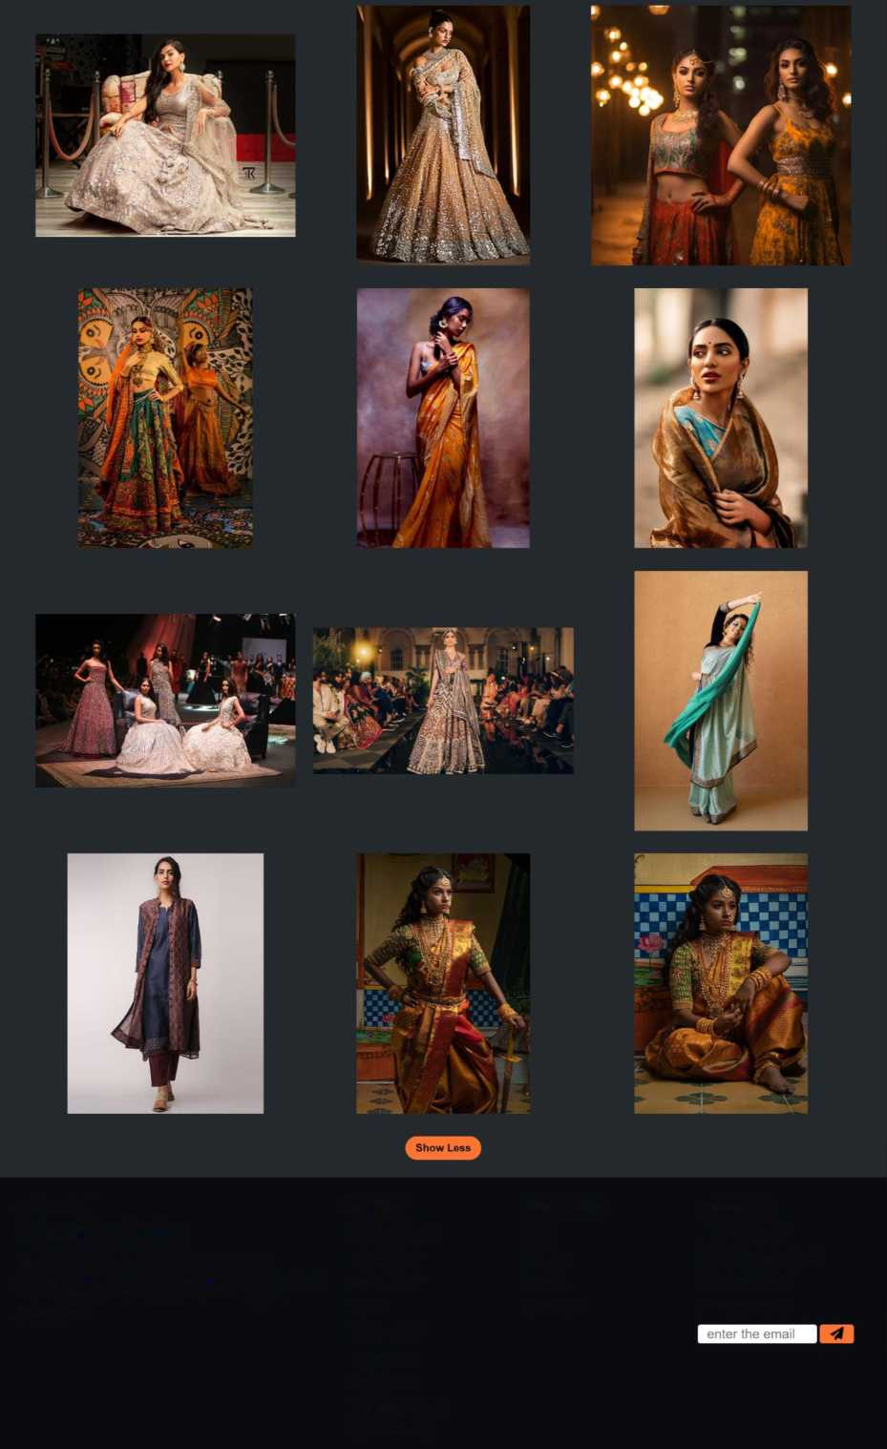
Welcome to,
Pixenture Labs
Pixenture lab is one stop solution for all kind of Photography n as well as videogrphy ii. You can recruit Photographers and videographers based on your requirement
Services | Quick Links | Contact Us
Wedding shoots | home | n /pixenturelabs
Fashion shoot | about us | (D/ pixenturelabsofficial
Portrait shoot | services | fO/pixenture labs
Events Models Shoots Short Films Baby Shoots Real Estate Shoots Product Shoots | contact us | X/pixenturelabs

Slide 23
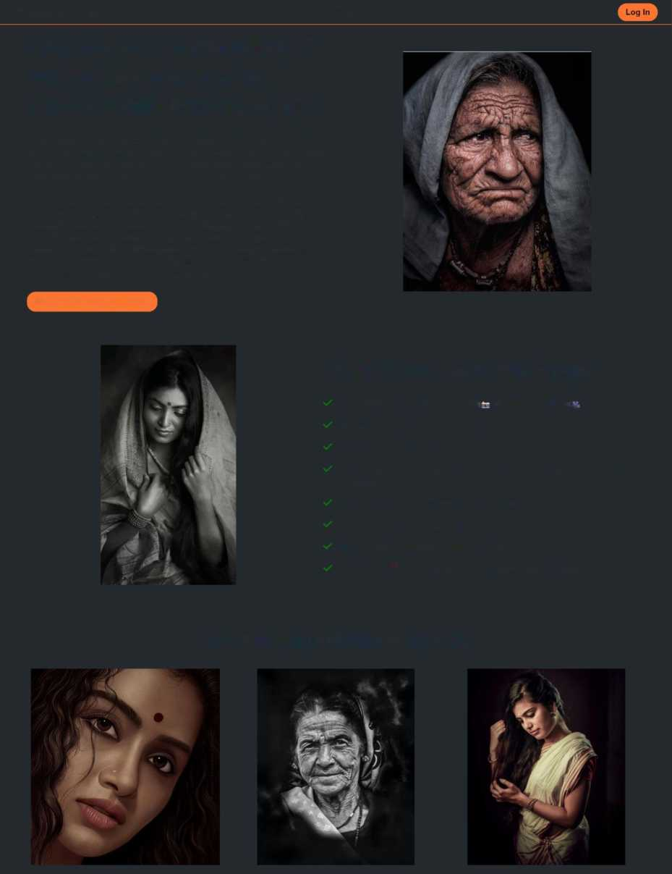
Portrait service Page:-
Pixenture Labs
Home
About Us Services Contact Us
Capture your personality of portraiture memorable moment with Pixenture Labs
Portrait photography aims to capture the identity, personality, and essence of a subject utilizing photographic techniques such as composition, lighting, and posing. There are various types of portrait photography that are dependent on the subject of the portrait as well as the style.
Portrait photography, or portraiture, is a type of photography aimed toward capturing the personality of a person or group of people by using effective lighting, backdrops, and poses.A portrait photograph may be artistic or clinical.Portrait photography is a very well-known and popular style of photography. This style of photography is all about trying to capture the personality, identity, soul, and emotions of a person by utilizing the background atmosphere, poses, and lighting.
Book your Shoot Now!!!
Main Features of Package
We Provide Certified Photographers and videographers _
Make Up Artist Provided in Package Service duration: 2 days
Full Team of 2 Photographers and 2 videographers 1 makeup artist and 1 apprentise
Free Printed Album and Pendrive copy of shoot
Best and Latest Equipments in market
In Maharashtra 0 travelling charges will be charged
One Little gift f f from pixenture labs for your precious moment
Our Portrait shoot Projects

Slide 24
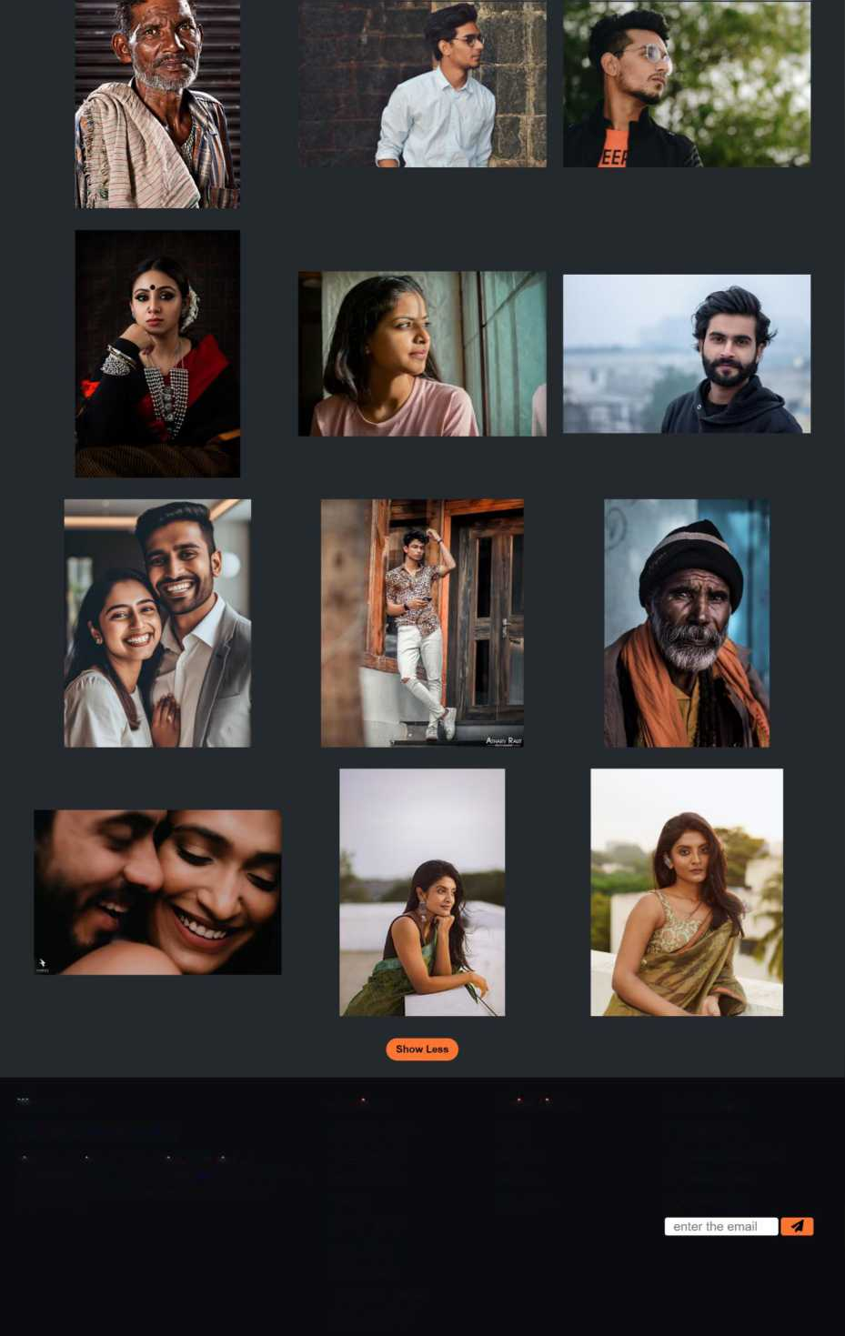
welcome to,
Pixenture Labs
Services
Wedding shoots Fashion shoot Portrait shoot Events
Models Shoots Short Films Baby Shoots Real Estate Shoots Product Shoots
Quick Links
home about us services contact us
Contact Us
FI /pixenturelabs 0/ pixenturelabsofficial EJ/pixenture labs X/pixenturelabs
Pixenture lab is one stop solution for all kind of Photography te as well as videogrphy*. You can recruit Photographers and videographers based on your requirement

Slide 25
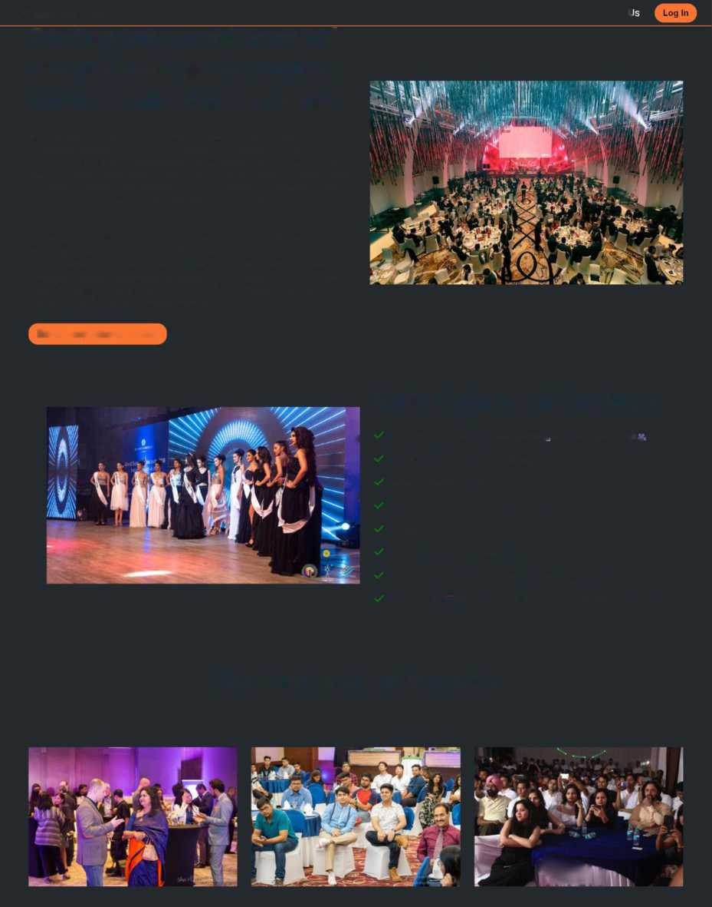
Event service Page:-
Pixenture Labs
Home About Us Services Contact L
Capture your most personal and professinal memorable moment with Pixenture Labs
In event photography, photographers capture professional pictures at large gatherings, whether they are on professional or personal occasions. The main task of this type of photography is to capture memorable moments from the event Photographers skillfully navigate the event capturing candid moments, emotions, and interactions that contribute to a comprehensive visual narrative of the occasion. With their keen eye and technical expertise, photographers create a timeless collection of images.
It encompasses a wide range of events, including but not limited to weddings, corporate seminars, conferences, trade shows, music concerts, sports tournaments, charity events, galas, and cultural festivals. These photographers are responsible for capturing the essence and moments of these diverse occasions, ensuring that the event is documented and the memories are preserved for years to come.
Book your Shoot Now!!!
Main Features of Package
^ We Provide Certified Photographers Jr and videographers _
Make Up Artist Provided in Package
Service duration: 2 days
a
Full Team of 3 Photographers and 3 videographers and 2 apprentise
Pendrive copy of 4k shoot
Best and Latest Equipments in market
In Maharashtra 0 travelling charges will be charged
One Little gift if from pixenture labs for your precious moment
Our Events shoot Projects
%Wl

Slide 26
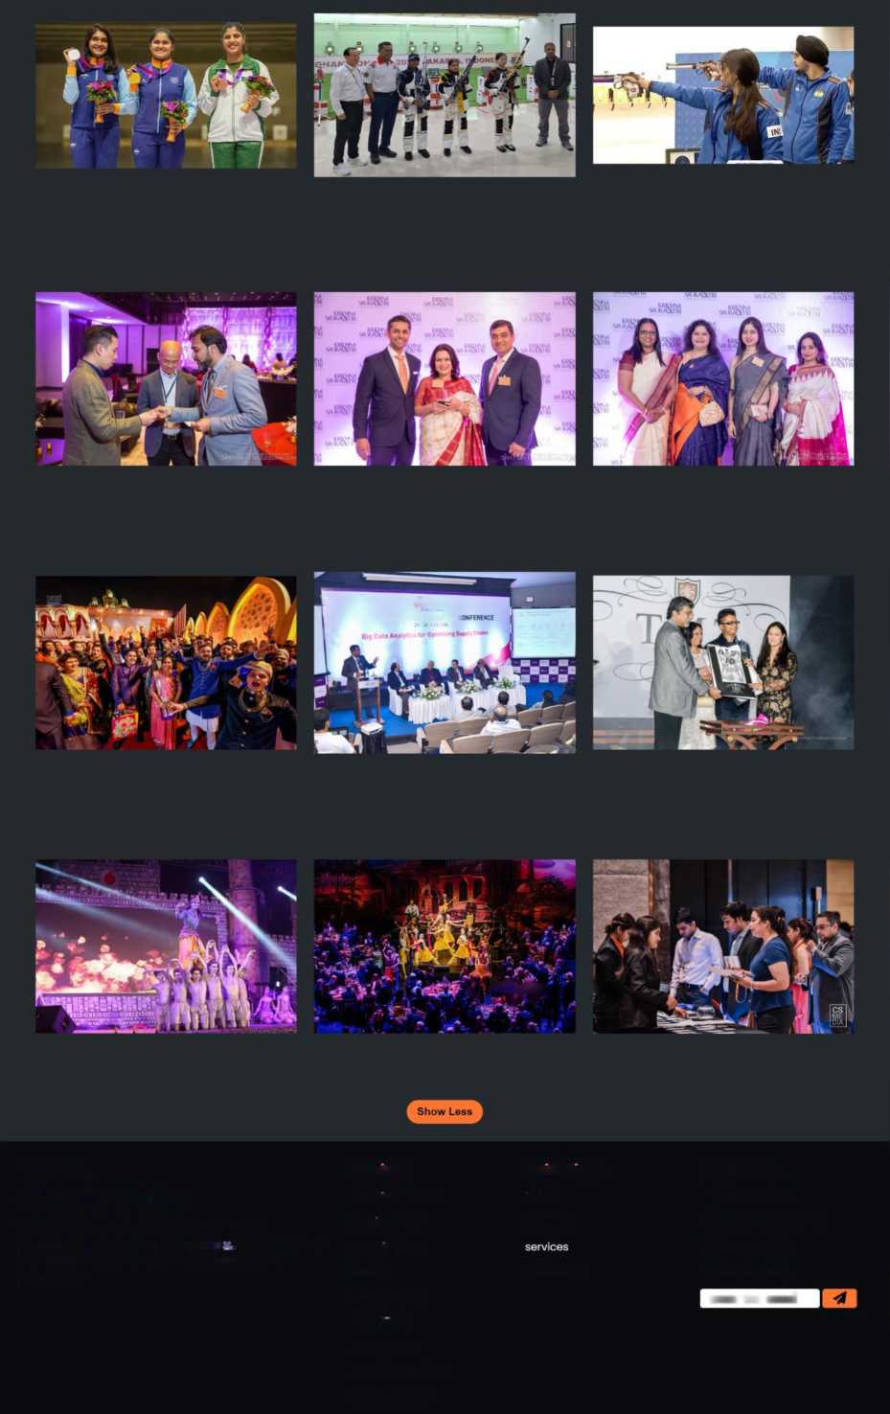
CSPJJMR
SPJIMR - POMS INDIA CHAPTER I
v ***** »
Welcome to,
Pixenture Labs
Services
Quick Links
Contact Us
Wedding shoots
nome
FI /pixenturelabs 0/pixenturelabsofficial
Pixenture lab is one stop solution for all kind of Photography ii as well as videogrphy . You can recruit Photographers and videographers based on your requirement
Fashion shoot
about us
EJ/pixenture labs X/pixenturelabs
Portrait shoot
Events
contact us
enter the email
Models Shoots
Short Films
Baby Shoots
Real Estate Shoots
Product Shoots

Slide 27
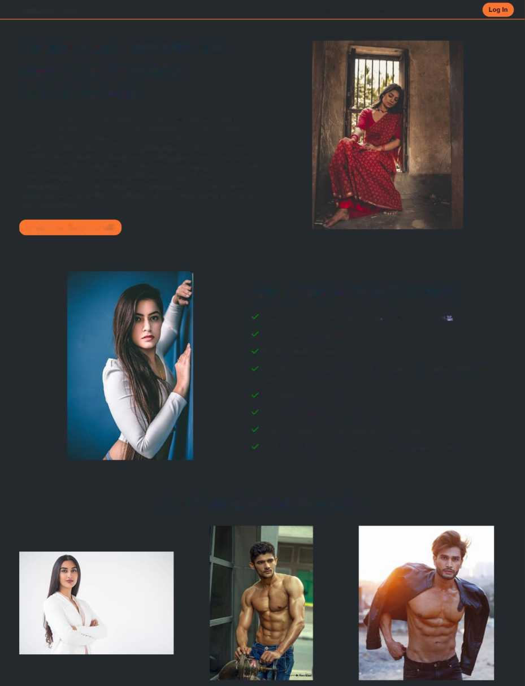
Models service Page:-
Pixenture Labs
Home
About Us Services Contact Us
Capture your memorable modelling pose with Pixenture Labs
A model photoshoot is a professional photography session in which models pose for photographs to showcase clothing, products, or their modeling abilities Model photography shoots are generally used in the fashion industry, whereby a model poses for a photographer either at a studio or in a specific shoot location. Although model photography shoots tend to refer to an actual model posing for the camera, it can also signify a photographer taking photographs of advertised goods for a magazine. Model photography shoots always require a photographer and a shoot location. Models pose for the camera as instructed by the photographer or the photo shoot coordinator.
Book your Shoot Now!!!
Main Features of Package
We Provide Certified Photographers is and videographers Make Up Artist Provided in Package Service duration: 2 days
Full Team of 2 Photographers and 2 videographers 1 makeup artist and 1 apprentise
Free Printed Album and Pendrive copy of shoot
Best and Latest Equipments in market
In Maharashtra 0 travelling charges will be charged
One Little gift li from pixenture labs for your precious moment
Our Model shoot Projects

Slide 28
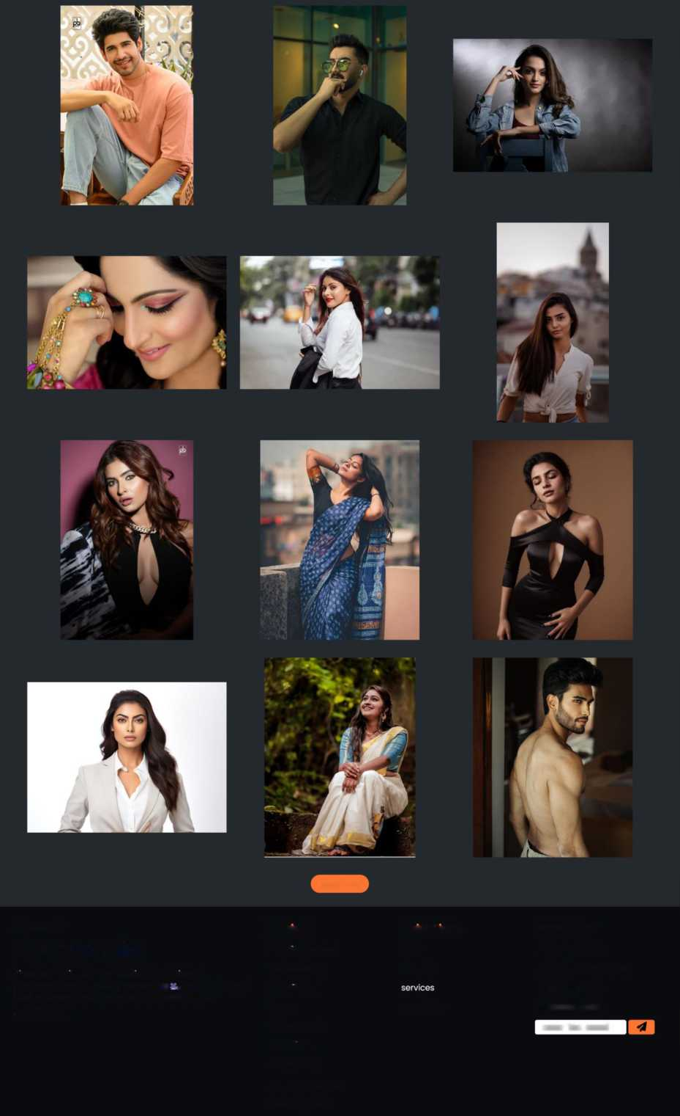
Show Less
Welcome to,
Pixenture Labs
Services
Quick Links
Contact Us
Wedding shoots
home
F3 /pixenturelabs @/pixenturelabsofficial
Pixenture lab is one stop solution for all kind of Photography is as well as videogrphy . You can recruit Photographers and videographers based on your requirement
Fashion shoot
about us
H/pixenture labs X/pixenturelabs
Portrait shoot
Events
contact us
enter the email
Models Shoots
Short Films
Baby Shoots
Real Estate Shoots
Product Shoots

Slide 29
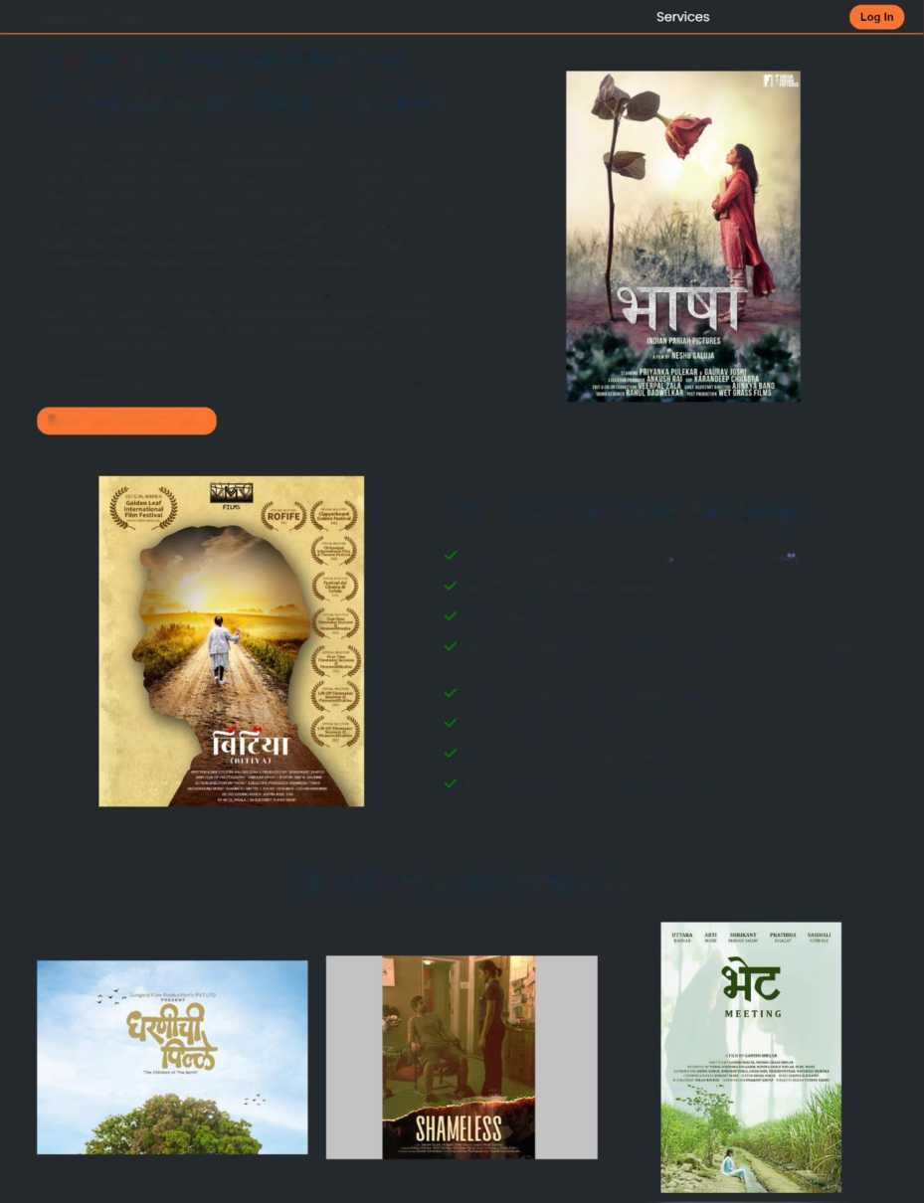
Short Films Page:-
Pixenture Labs
Home
About Us
Contact Us
capture a memorable flim synopsis with Pixenture Labs
Short films are often screened at local, national, or international film festivals and made by independent filmmakers with either a low budget or no budget at all. They are usually funded by one or more film grants, nonprofit organizations, sponsors, or personal funds. Short films are generally used for industry experience and as a platform to showcase talent to secure funding for future projects from private investors, a production company, or film studios. They can also be released with feature films, and can also be included as bonus features on some home video releases.
A compelling story is at the heart of any short film, but the best short films have a clear, concise, and often very simple premise, which is necessary if you only have minutes to tell your entire story. If possible, give your main character a very specific goal or a short time frame to reach it
A film synopsis is typically a one-page document that summarizes your film
Book your Shoot Now!!!
Main Features of Package
We Provide Certified Photographers tr and videographers _
Make Up Artist Provided in Package Service duration: 2 days
Full Team of 2 Photographers and 2 videographers 1 makeup artist and 1 apprentise
Free Printed Album and Pendrive copy of shoot
Best and Latest Equipments in market
In Maharashtra 0 travelling charges will be charged
One Little gift it from pixenture labs for your precious moment
Our Short Films Projects

Slide 30
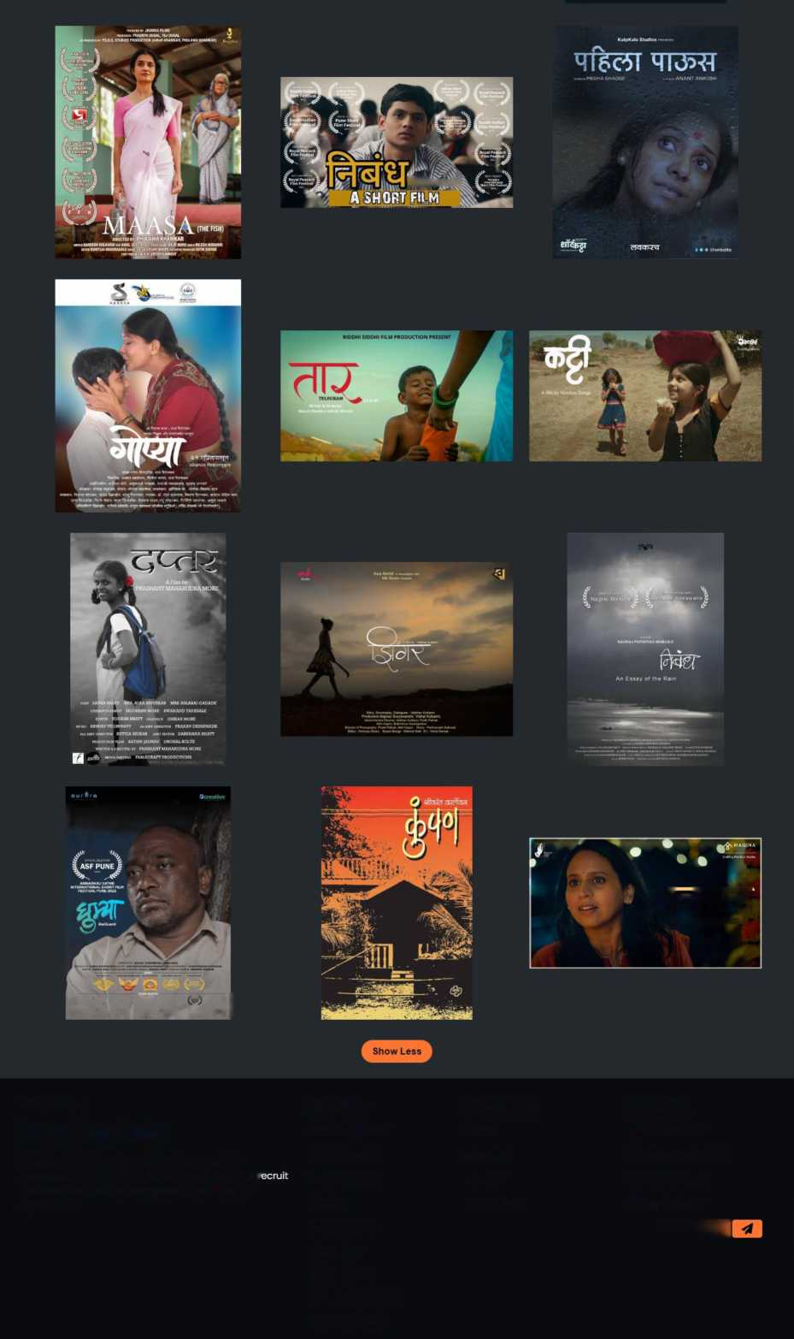
P^mSS'AYv)
RUDRATARA PRODUCTION Presents
65th National Awards 2018 NaifrFcatui,jeJ;llm
w
3[OTK3
A BHADIPA SHORTFILM
fa ss m M cs> w| « C*> (- ) « < V ) <H> C -) I
Welcome to,
Pixenture Labs
Pixenture lab is one stop solution for all kind of Photography 3i as well as videogrphy K. You can r Photographers and videographers based on your requirement
Services | Quick Links | Contact Us
Wedding shoots | home | n /pixenturelabs
Fashion shoot | about us | ©/pixenturelabsofficial
Portrait shoot | services | Hfl/pixenture labs
Events Models Shoots Short Films Baby Shoots Real Estate Shoots Product Shoots | contact us | X/pixenturelabs E33SI

Slide 31
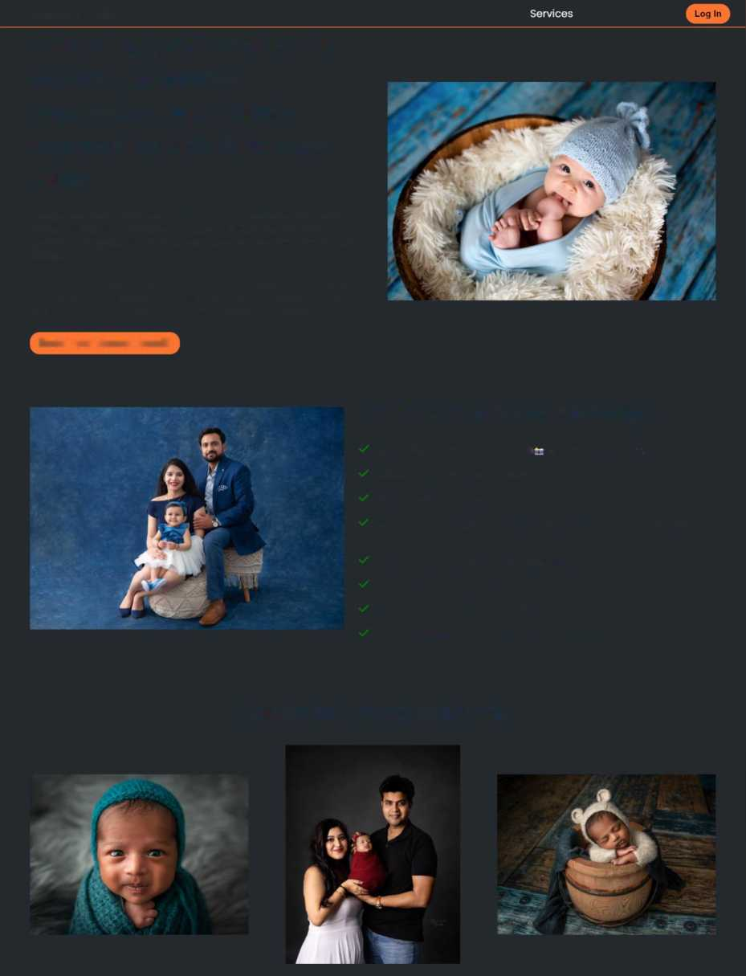
Baby Shoot Page:-
Pixenture Labs
capturing your memorable moment of babies expressions and family connection with Pixenture Labs
Home
About Us
Contact Us
Pamper your newly-borns and bundles of joy by capturing their sweet moments which you will cherish for the rest of your lives. For all the mommies an daddies out there, here’s where you can go to get your babies clicked.
Her charm and patience with babies are known to bring out the best in them and you will not be disappointed by the cute pictures that you will get. She also does professional shoots for baby catalogues and advertisements.
'3T - v
Book your shoots Now!!!
Main Features of Package
We Provide Certified Photographers and videographers L Make Up Artist Provided in Package Service duration: 2 days
Full Team of 2 Photographers and 2 videographers 1 makeup artist and 1 apprentise
Free Printed Album and Pendrive copy of shoot
Best and Latest Equipments in market
In Maharashtra 0 travelling charges will be charged
One Little gift It from pixenture labs for your precious moment
Our Baby shoot Projects

Slide 32
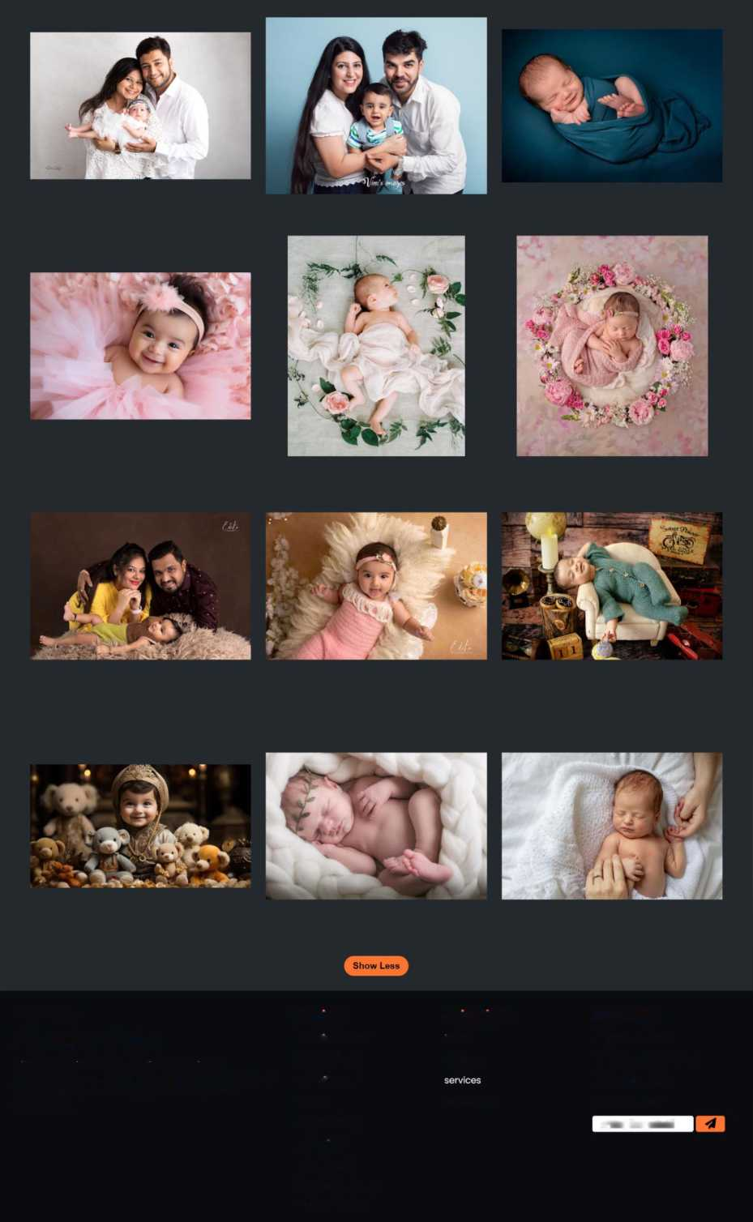
Welcome to,
Pixenture Labs
Services
Quick Links
Contact us
Wedding shoots
nome
F3 /pixenturelabs ®/pixenturelabsofficial
Pixenture lab is one stop solution for all kind of Photography is as well as videogrphy £. You can recruit Photographers and videographers based on your requirement
Fashion shoot
about us
H/pixenture labs X/pixenturelabs
Portrait shoot
Events
contact us
enter the email
Models Shoots
Short Films
Baby Shoots
Real Estate Shoots
Product Shoots

Slide 33
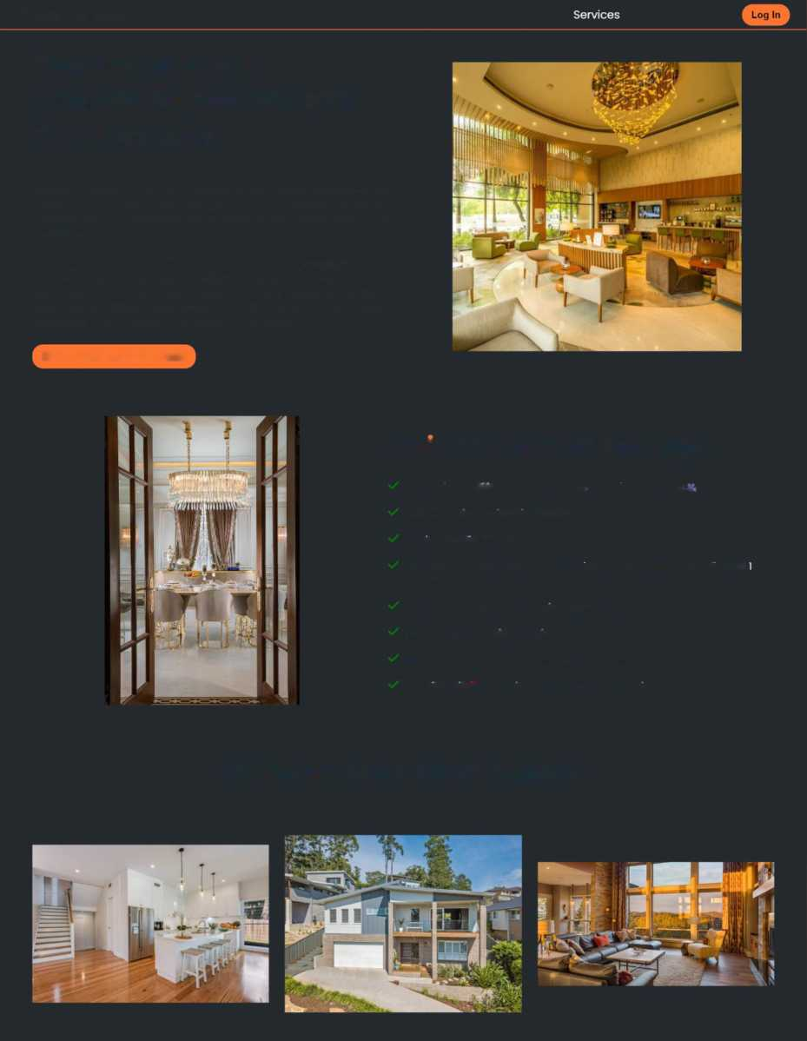
Real Estate Shoot Page:-
Pixcnturc Labs
Home
About Us
Contact Us
Capture your real commercial moment with Pixenture Labs
Real estate photography is a branch of commercial photography where the subject is a property that can be residential, commercial, industrial or even vacant land. And each of these categories has sub-categories as well. For example, residential properties can be family homes, condos, apartments, co-ops, etc.
As it is a commercial type of photography, the scope is typically to showcase the property's characteristics to attract potential clients to buy, rent, or sublet. Real estate photography is not about a single image; it's always about a SERIES of photographs. You will generally need to capture not only the interior but also the building, the surroundings, etc.
Book your Shoots Now!!!
Main Features of Package
We Provide Certified Photographers i£ and videographers _
Make Up Artist Provided in Package
Service duration: 2 days
Full Team of 2 Photographers and 2 videographers 1 makeup artist and apprentise
Free Printed Album and Pendrive copy of shoot
Best and Latest Equipments in market
In Maharashtra 0 travelling charges will be charged
One Little gift ll from pixenture labs for your precious moment
Our Real Estate shoot Projects

Slide 34
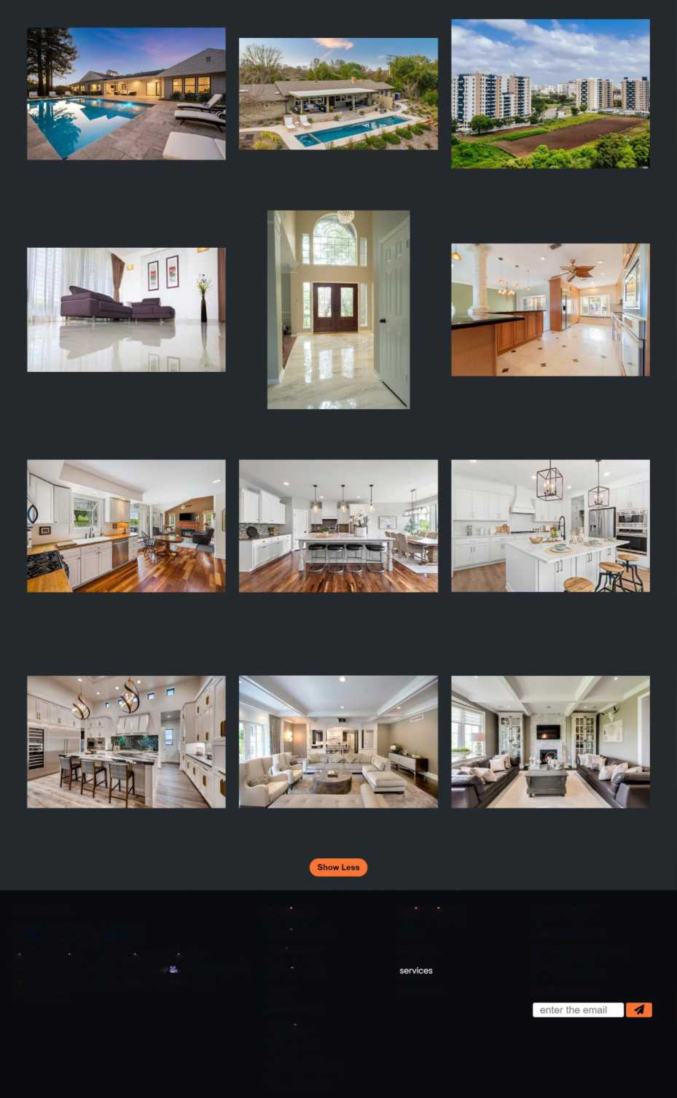
* fo
Welcome to,
Services
Quick Links
Contact Us
Pixenture Labs
Wedding shoots
home
n /pixenturelabs
Pixenture lab is one stop solution for all kind of Photography it as well as videogrphy . You can recruit Photographers and videographers based on your requirement
Fashion shoot
about us
(D/pixenturelabsofficial 03/pixenture labs X/pixenturelabs
Portrait shoot
Events
contact us
Models Shoots
Short Films
Baby Shoots
Real Estate Shoots
Product Shoots

Slide 35
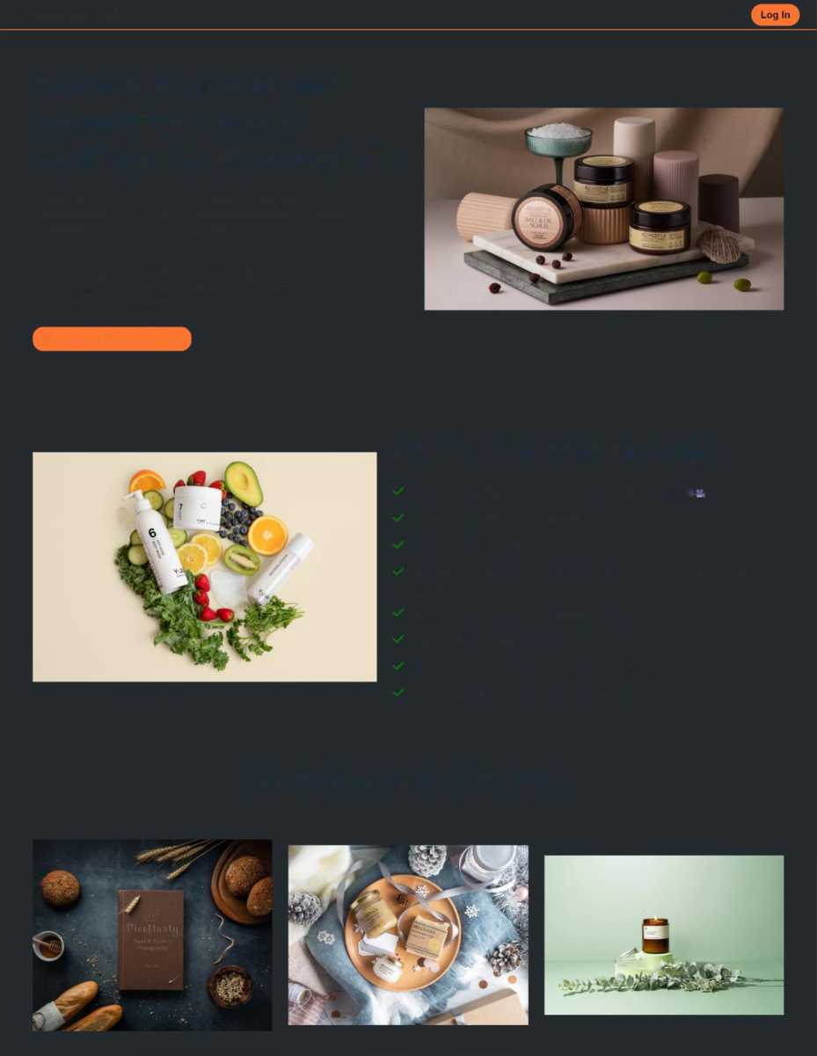
Product Shoot Page:-
Pixenture Labs
Home
About Us Services Contact Us
Capture pictures of your memorable products emotions with Pixenture Labs
Product photography is a branch of photography that involves photographing products with the intention of displaying, promoting, and highlighting certain features of a product Today, most commonly, product photography is utilized on e-commerce stores or on social media.
Beauty photography goes beyond just taking pictures of your products—it's about telling a story, evoking emotions, and making your potential customers feel a connection with your brand.
Book your Shoot Now!!!
Main Features of Package
We Provide Certified Photographers is and videographers Make Up Artist Provided in Package Service duration: 2 days
Full Team of 2 Photographers and 2 videographers 1 makeup artist and 1 apprentise
Free Printed Album and Pendrive copy of shoot
Best and Latest Equipments in market
In Maharashtra 0 travelling charges will be charged
One Little gift tt from pixenture labs for your precious moment
Our Product shoot Projects
fyvti)

Slide 36
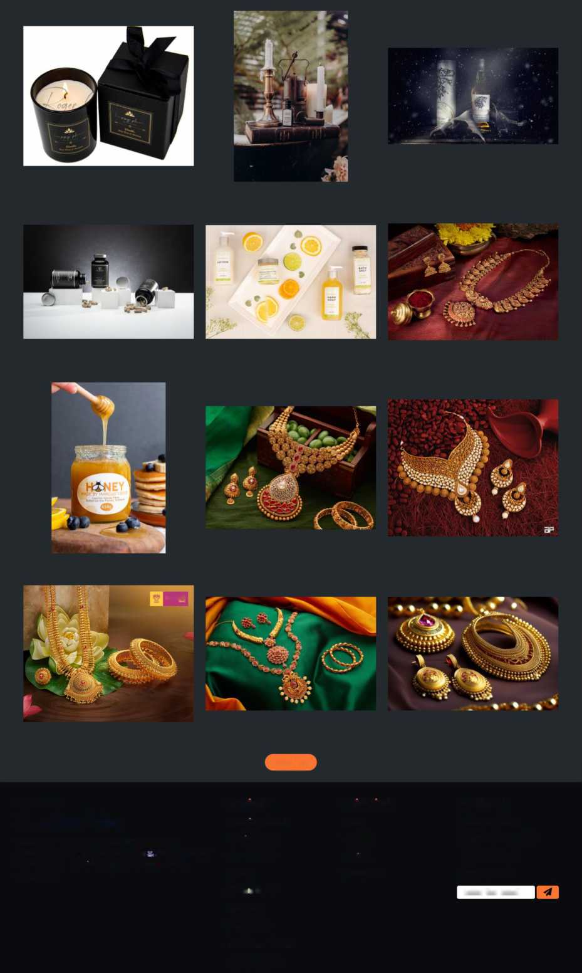
atn&aft
Show Less
Welcome to,
Pixenture Labs
Pixenture lab is one stop solution for all kind of
Services
Quick Links
Contact Us
Wedding shoots
home
FI /pixenturelabs
Photography St as well as videogrphy . You can recruit
Fashion shoot
about us
(U/pixenturelabsofficial
Photographers and videographers based on your requirement
Portrait shoot
services
03/pixenture labs
Events
contact us
X/pixenturelabs
Mode s Shoots
enter the email
Short Films
Baby Shoots
Real Estate Shoots
Product Shoots

Slide 37
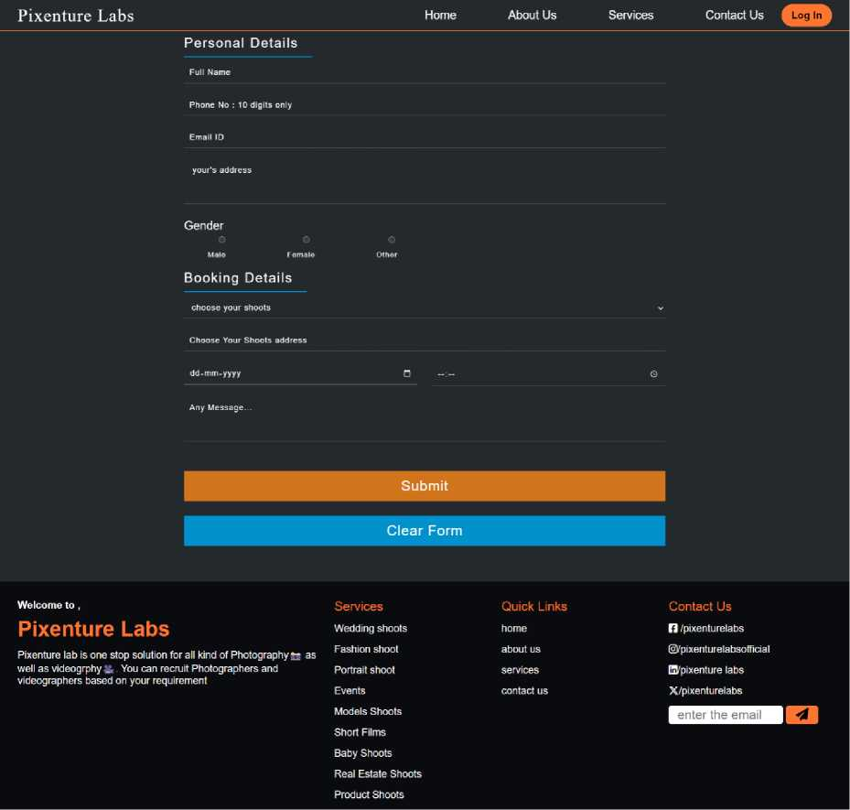
Booking Page:-

Slide 38
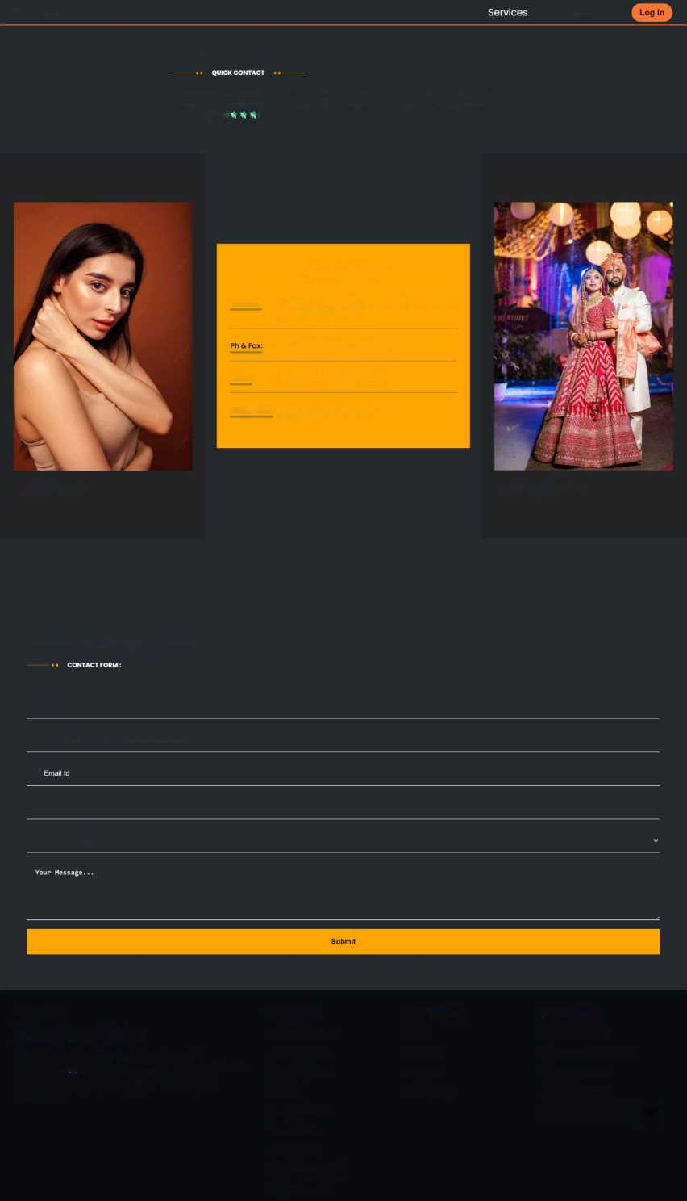
Contact Us Page:-
Pixenture Labs
Home
About US
Contact Us
CONTACT US
Pixenture labs is one stop solution for all kind of Photography^. You can recruit photogrphers based on your requirement and Pixenture labs offers And Best services in the market at most affordable price I
CONTACT OUR TEAMS
Address: S.No.17, near pasodya vitoba madir pixenture lab
shivajinagar pune-05
+91 3456788906 +91 6789345674
Email: pixenturelab31@gmail.ccom
Office Time: Mon-Fri: 9:30am - 6:30pm Sat-Sun: Closed
model shoots
wedding shoots
SEND YOUR MESSAGE
Name
Phone No: please enter 10 digit phone number
Address
choose your shoots
Welcome to,
Pixenture Labs
Pixenture lab is one stop solution for all kind of Photography li as well as videogrphy -S,. You can recruit Photographers and videographers based on your requirement
Services | Quick Links | Contact Us
Wedding shoots | home | 11 /pixenturelabs
Fashion shoot | about us | 0/ pixentu rela bsoff ic ia I
Portrait shoot | services | EJ/pixenture labs
Events Models Shoots Short Films Baby Shoots Real Estate Shoots Product Shoots | contact us | X/pixenturelabs EBS9HE1

Slide 39
Conclusion
^ At the end after completing the website the major goal of providing high quality services with ease is accomplished
^ The major goal of creating UI which is attractive and easy to use this goal is achieved as well
^ Providing one stop solution website this goal is as well achieved at low cost
^ By including sitemap , color scheme , minimal layout and Call through action these things make this website easy to use and consistent
^ Making the booking process and scheduling more easy and less time and effort intensive is achieved
^ The time of customer in searching and scheduling and booking became easy
^ By making the process online and publishing on web studio can get more customers from abroad than regular
^ Since website is responsive till 300 pixels any device even smallest smartphone can access it easily without having any problem

Slide 40
Bibliography
> https://developer.mozilla.org/en-US/docs/Web/IavaScript
> https://stackoverflow.com/
> https://www.w3schools.com/
> https://in.pinterest.com/
> https://www.shutterstock.com/
> https://dribbble.com/tags/photographer%20website

